Slide 1
HSBC Ability Lions 10 Jan 2022

Slide 2
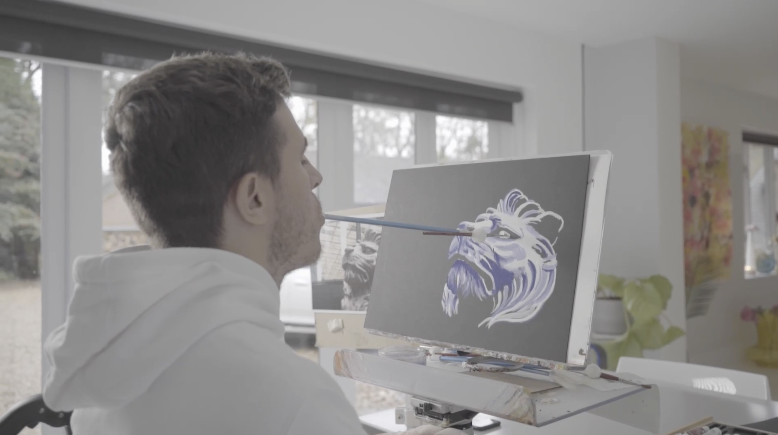
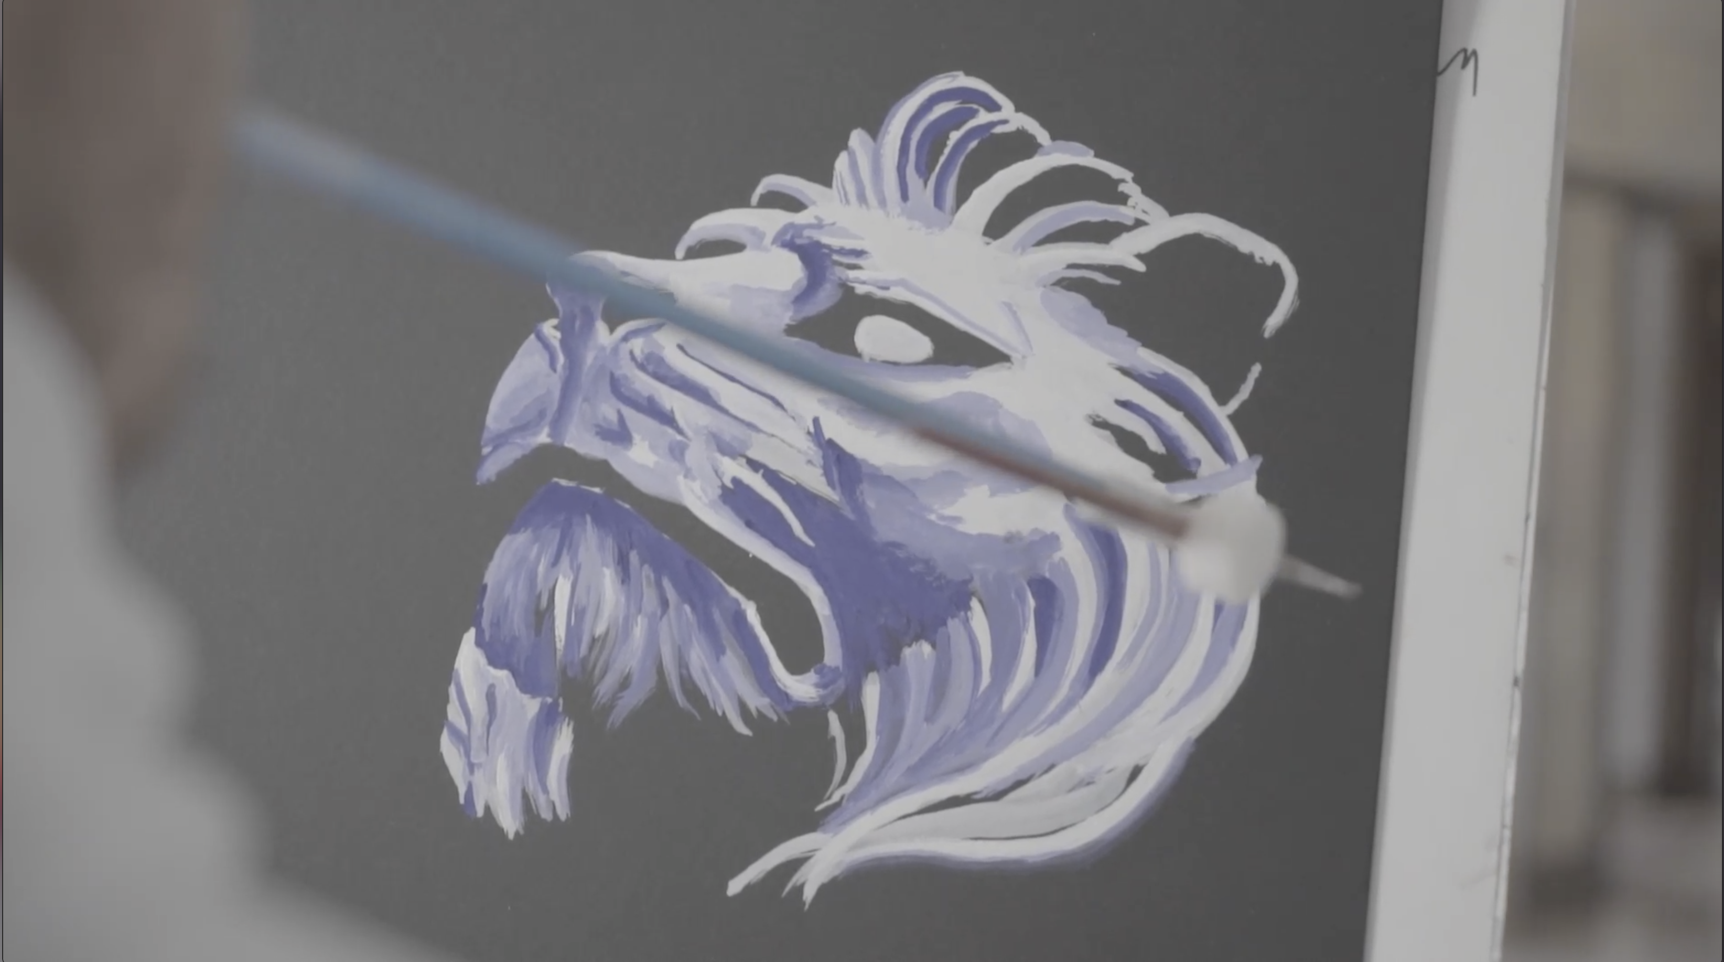
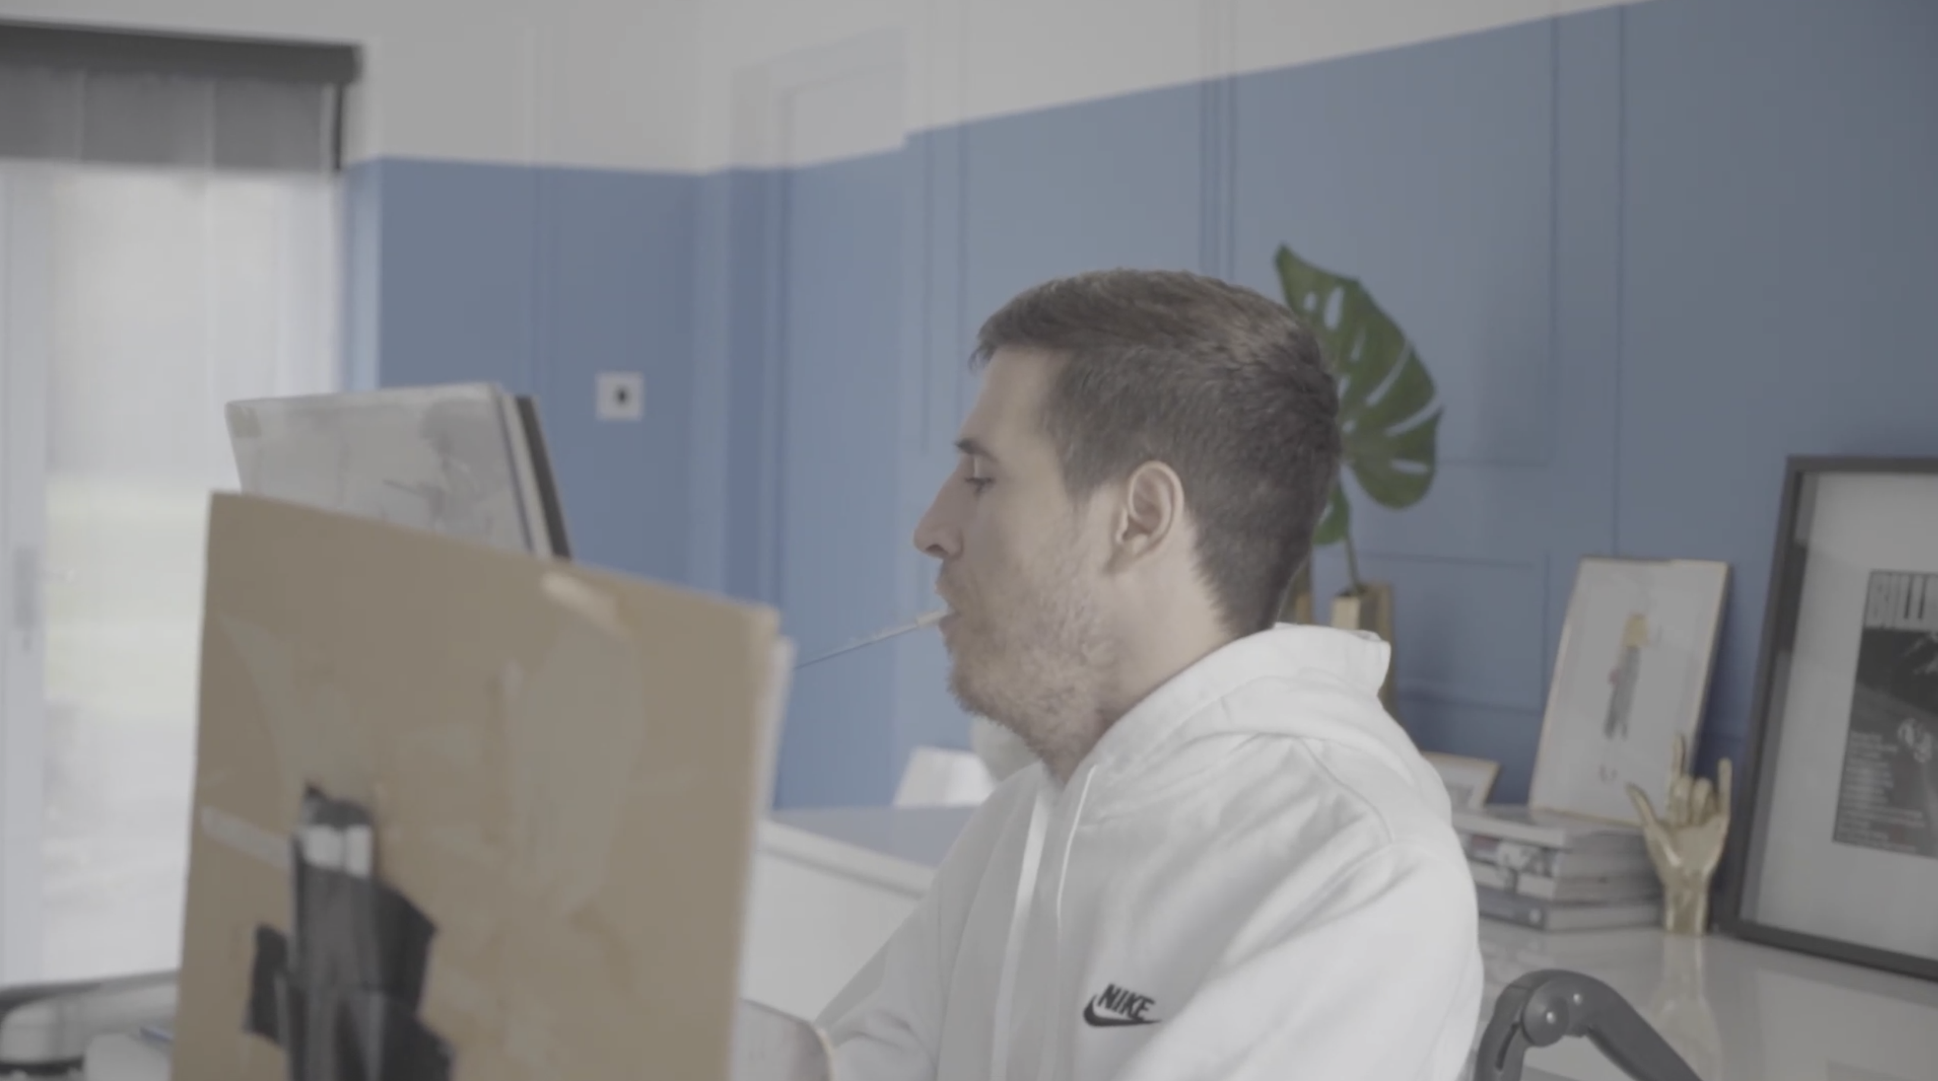
A unique commission by mouth artist. Henry Fraser
https://henryfraserart.com/art/

Slide 3
A unique commission by mouth artist. Henry Fraser
https://henryfraserart.com/art/

Slide 4
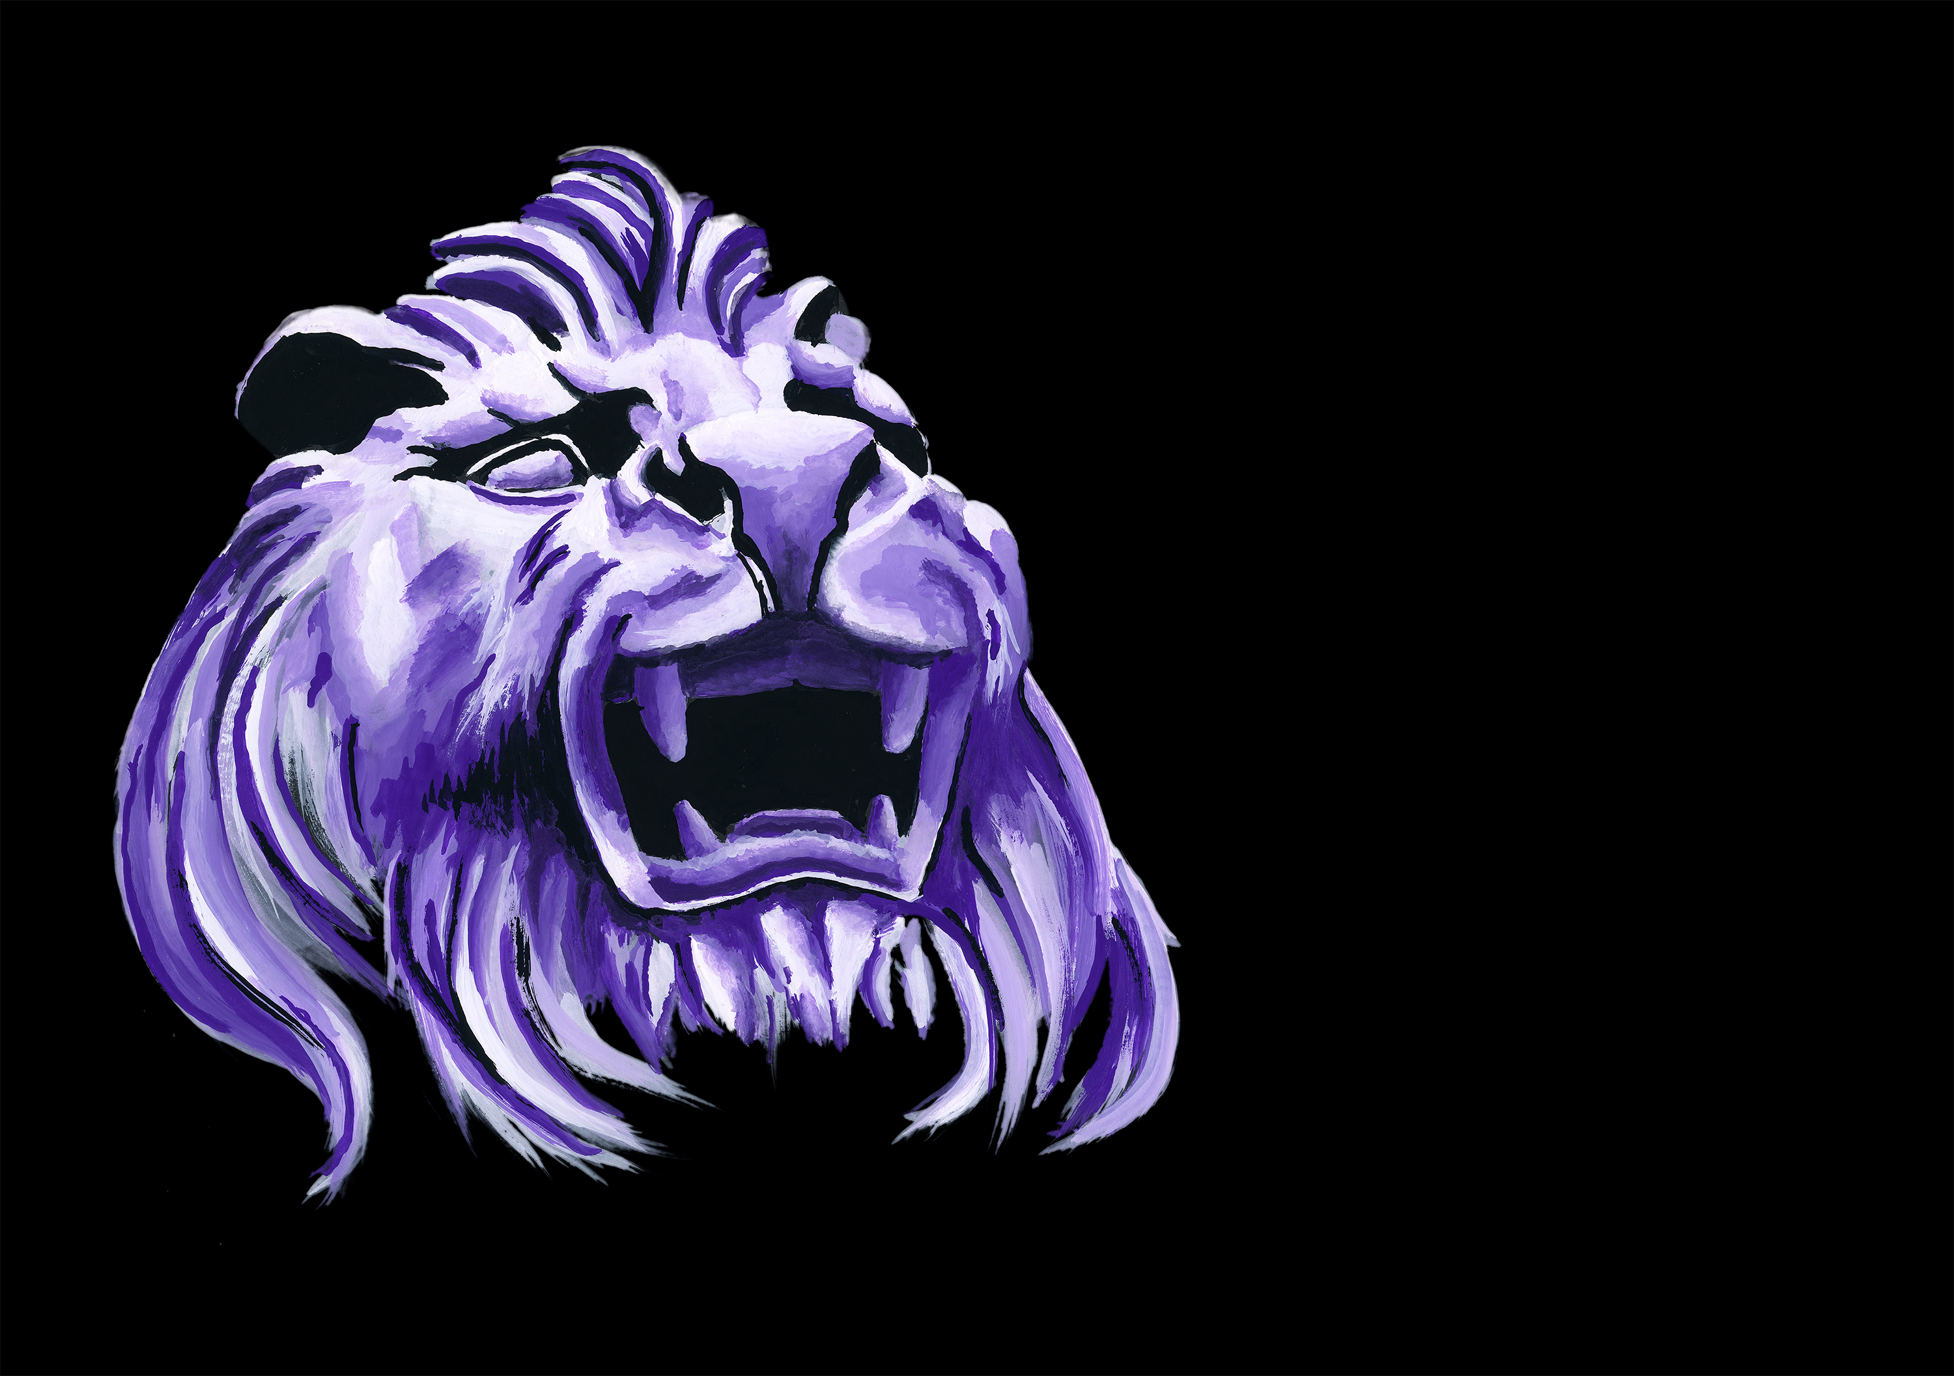
Depicting our HSBC Lions : 'Stephen'

Slide 5
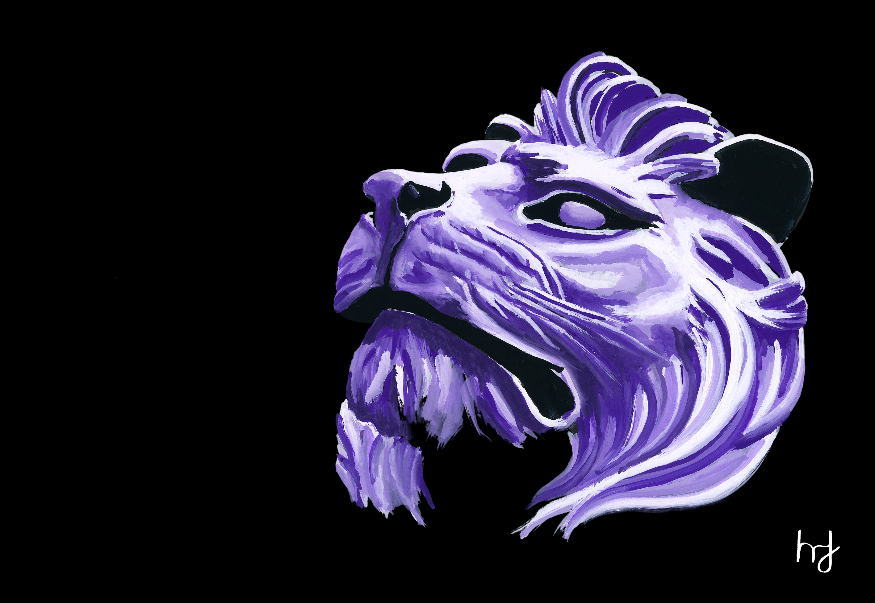
Depicting our HSBC Lions : 'Stitt'

Slide 6
The originals will be framed as a Diptych

Slide 7
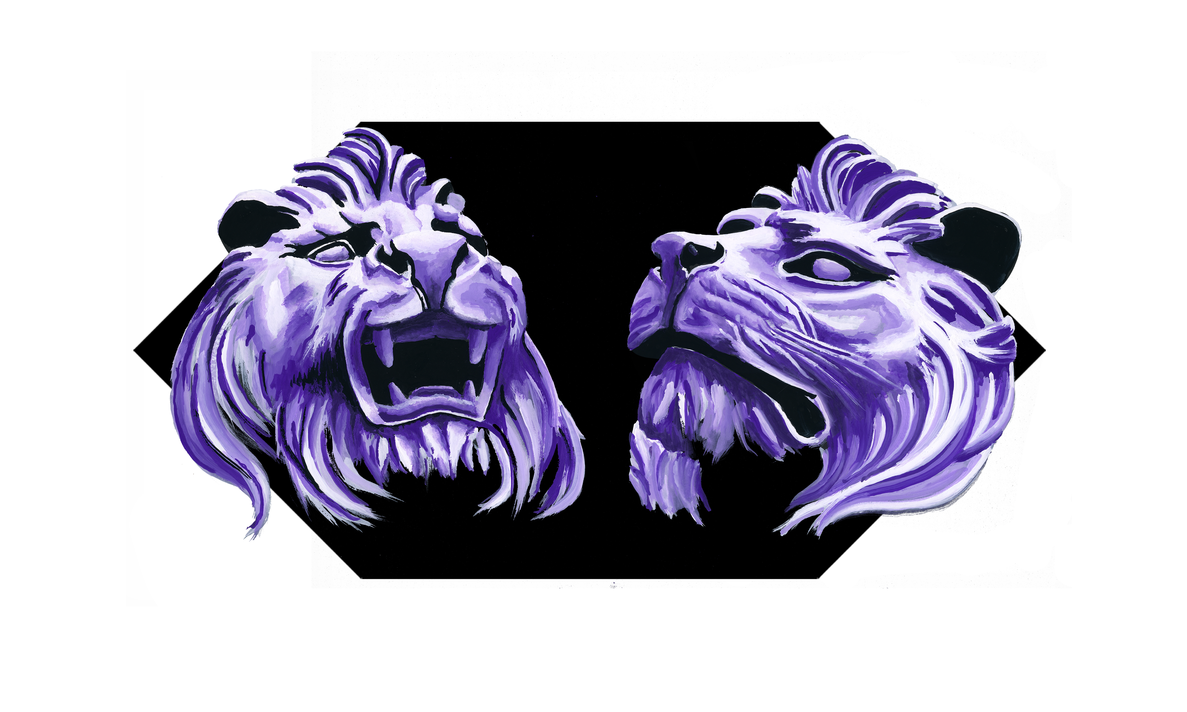
And displayed digitally in an open hex

Slide 8
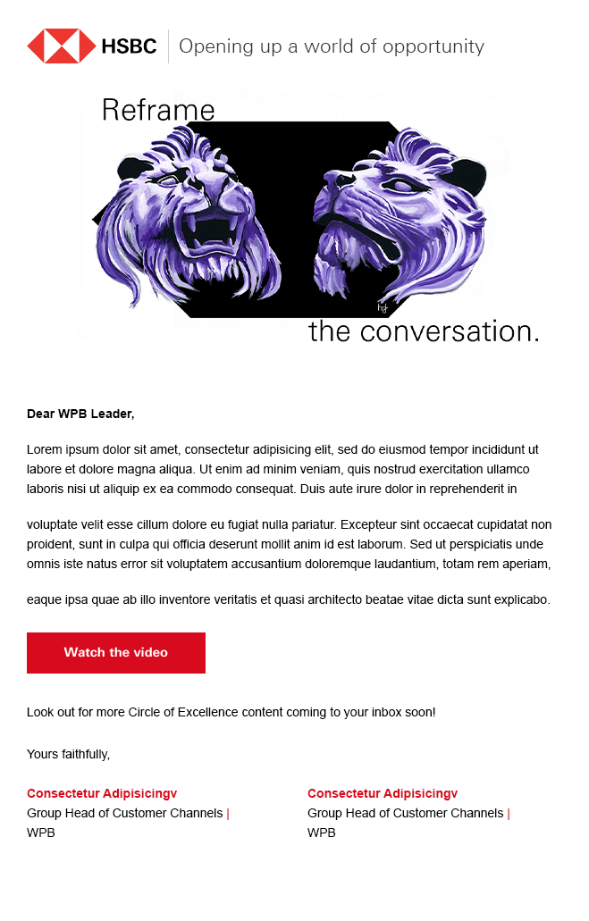
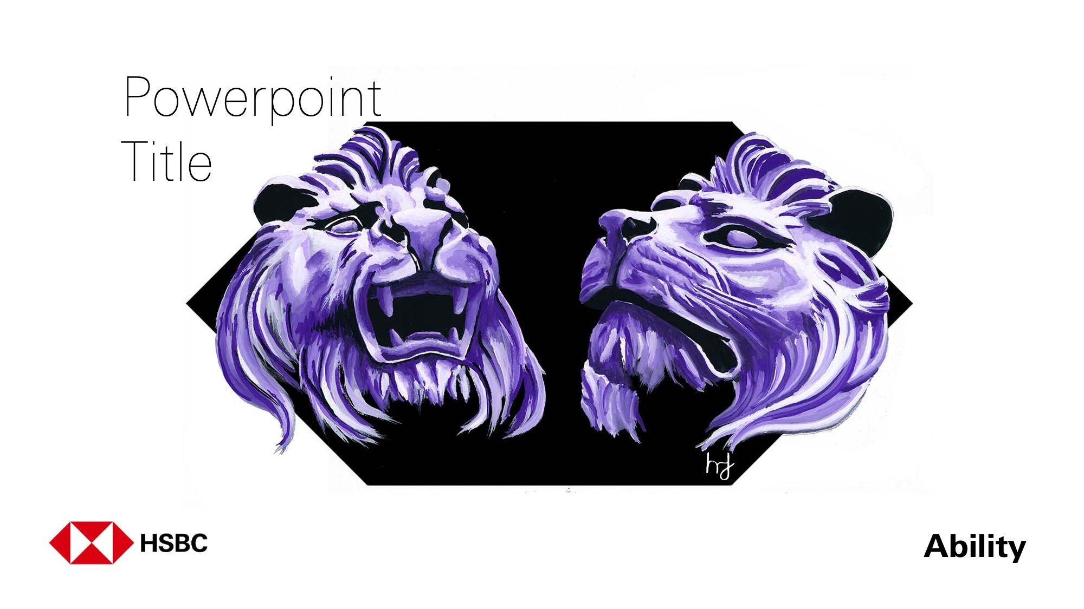
Examples of use

Slide 9
Thank you

