Slide 1
Backstop Homebase Video
Script and storyboard
6 April 2023

Slide 2
Video script draft 1
FADE IN
Imagine having a clear, detailed view of everything your team is doing for your clients…
…any time you want, with zero effort or hassle…
…so you spend less time finding information…
…and more time analysing and acting on it.
Imagine no more.
Backstop Home Base makes critical information available to you…
…in a dynamic, unified view…
…that’s updated with each refresh …
…and personalized to the needs of each team member.
Monitor your top investor interactions…
…to understand how - and how effectively…
…clients are being served.
Keep tabs on recent and upcoming meetings.
Get a snapshot of your entire team’s opportunity pipeline…
…to see what deals are closing…
…identify bottlenecks…
…and focus on closing the right prospects at the right time.
Looking for a subscription document?
There it is, at your fingertips, in the streaming document feed.
Everything you need is here in Backstop Home Base…
…with the option to drill down as needed.
No need to request a report or wait till your Monday meeting…
For a new way to start and end your day…
…talk to us about Backstop Home Base.
Another swift, simple route to a single point of truth…
…courtesy of Backstop Solutions.
FADE OUT

Slide 3

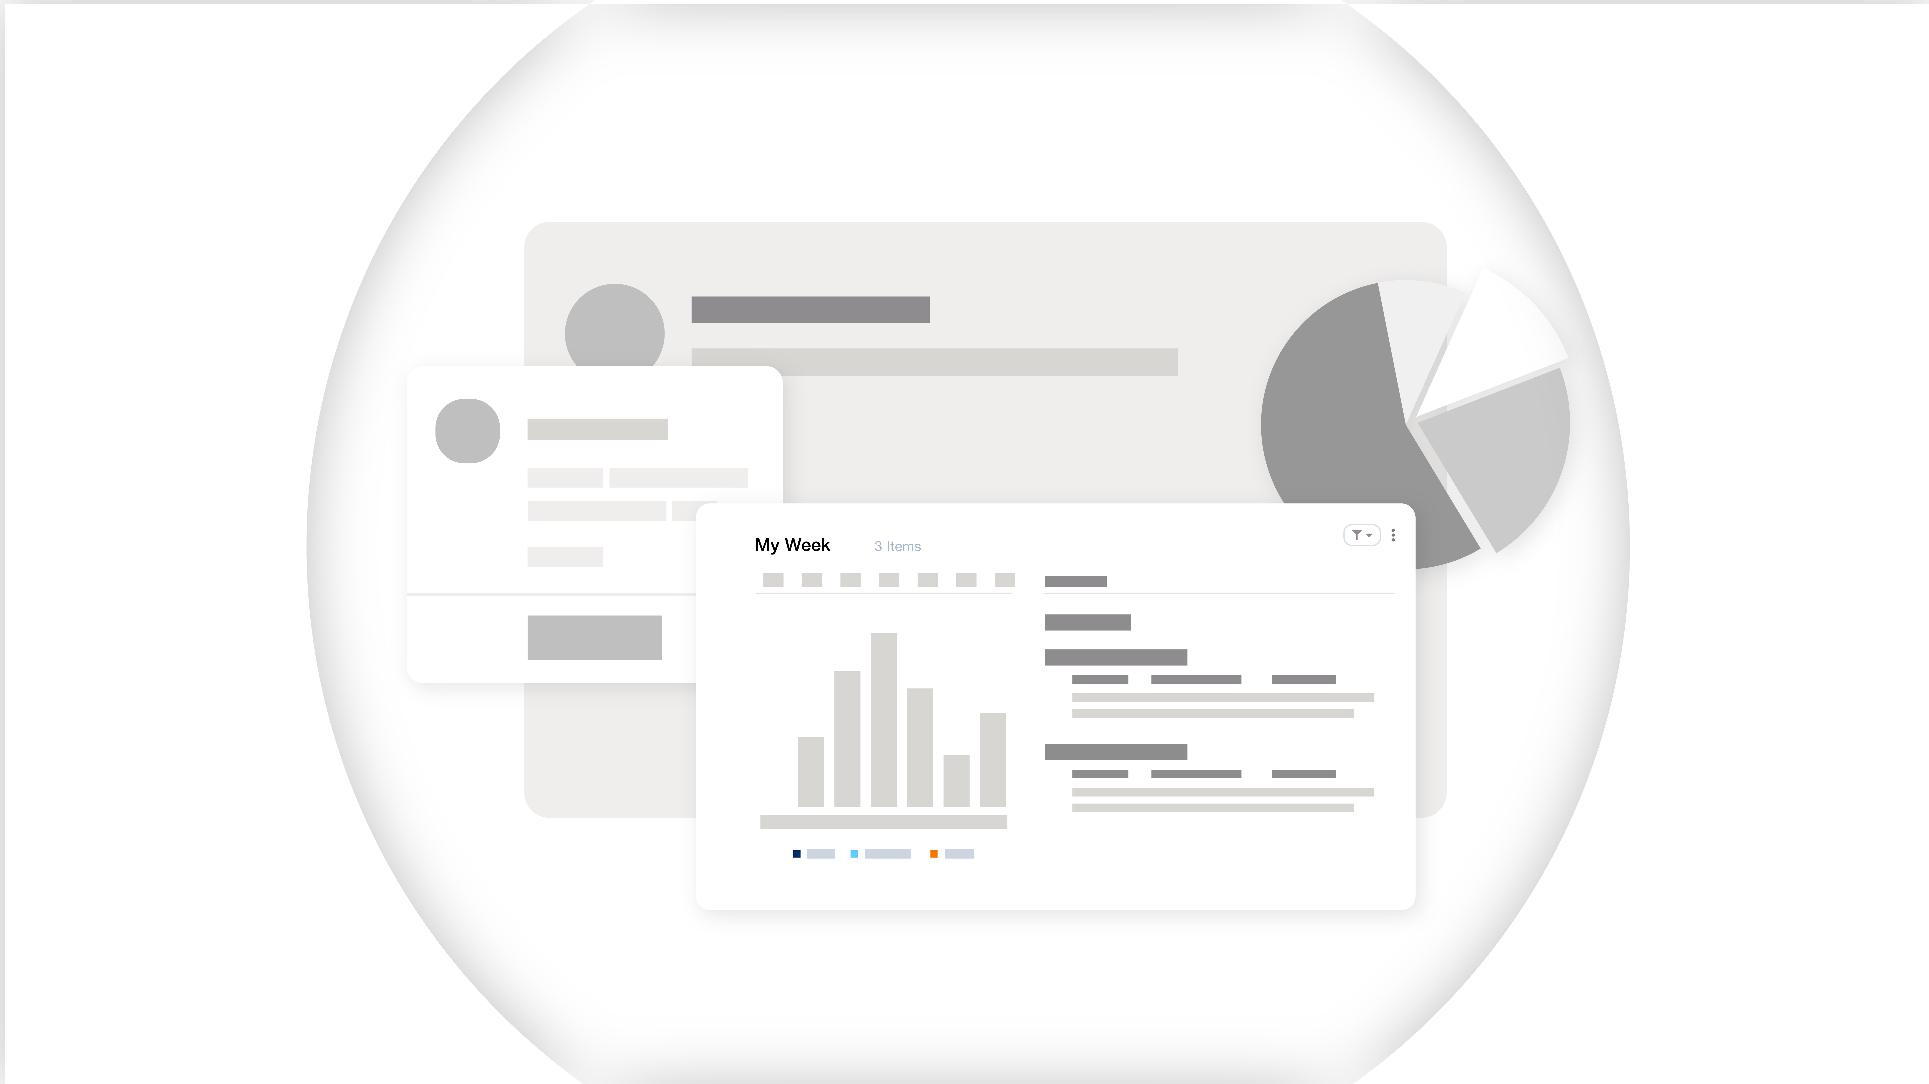
Storyboard
Imagine having a…
…clear…
A blurry grey object is seen on screen
‘lens’ flys in and focuses (imagine like in an opticians)

Slide 4
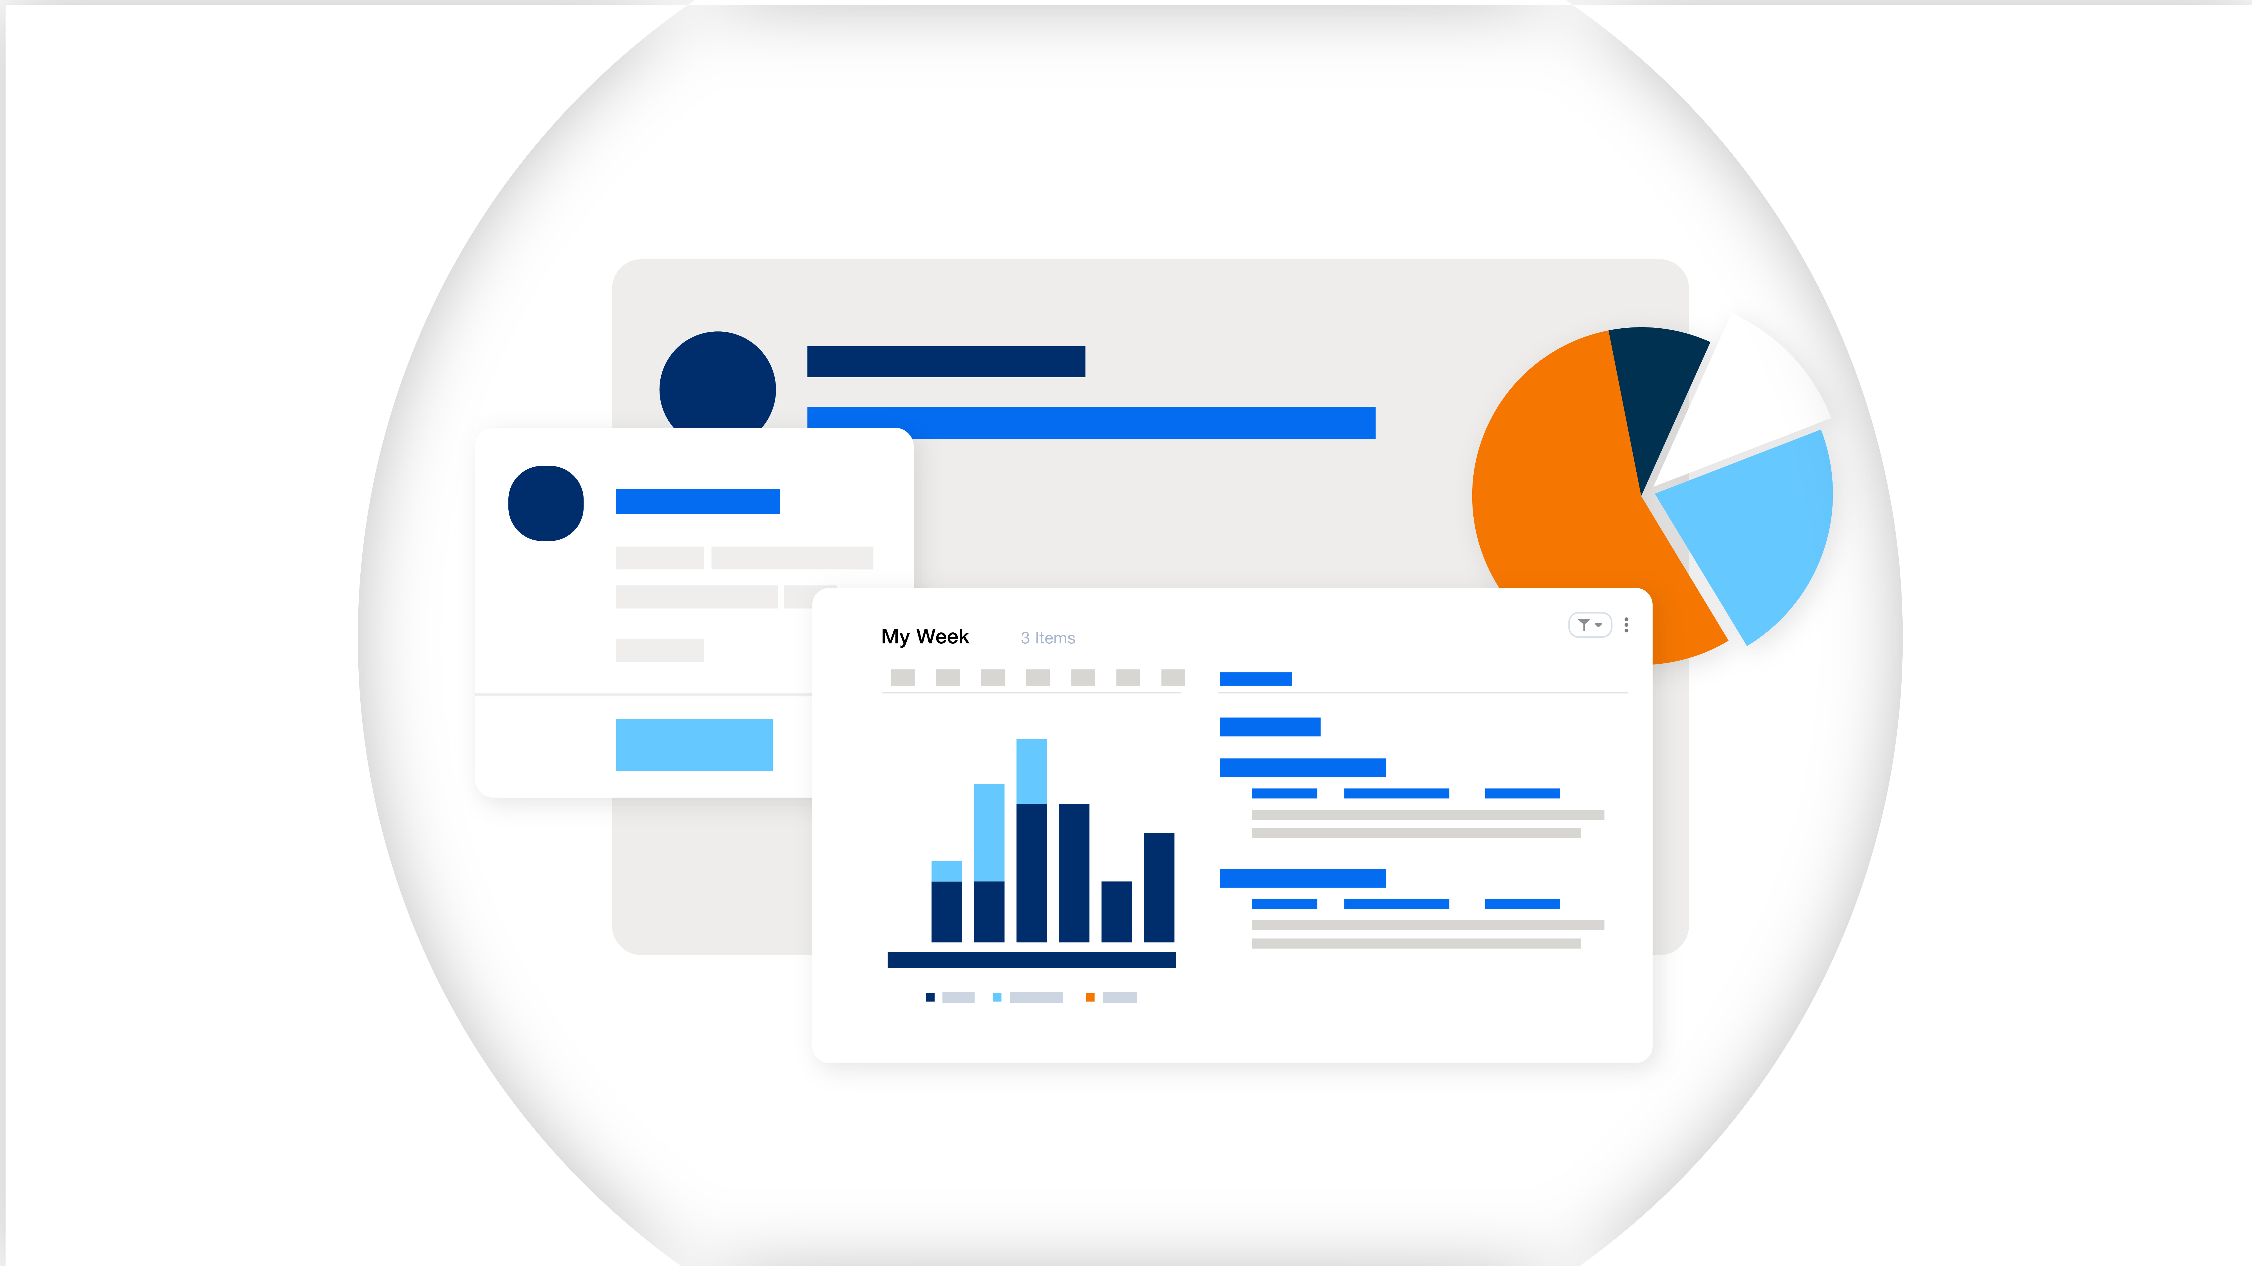
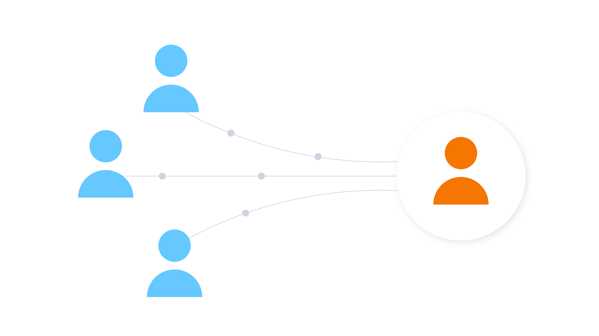
Storyboard
…detailed view of everything …
…your team is doing for your clients…
Another lens rotates in, and everything is in colour
Team members are sending information to clients

Slide 5
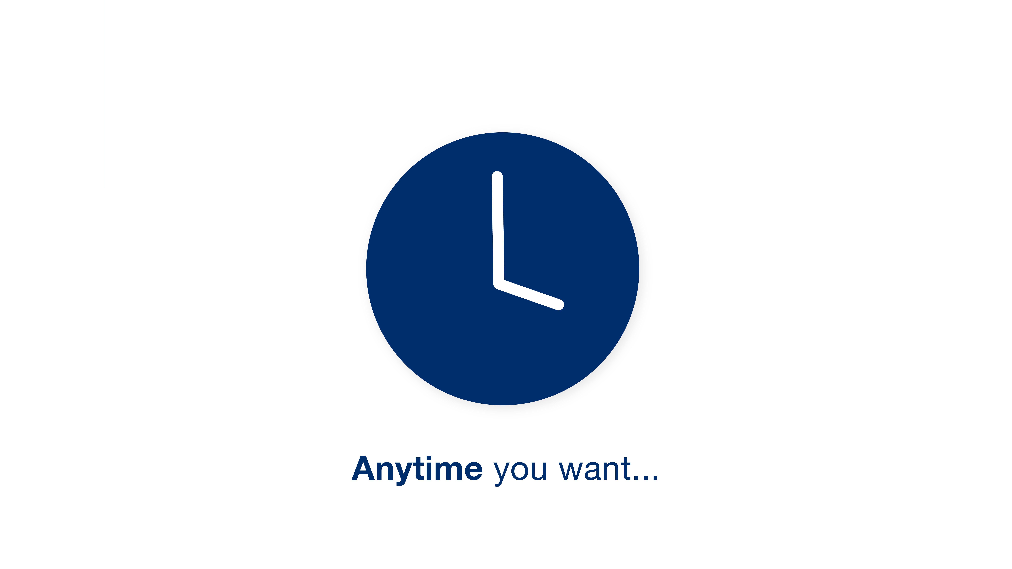
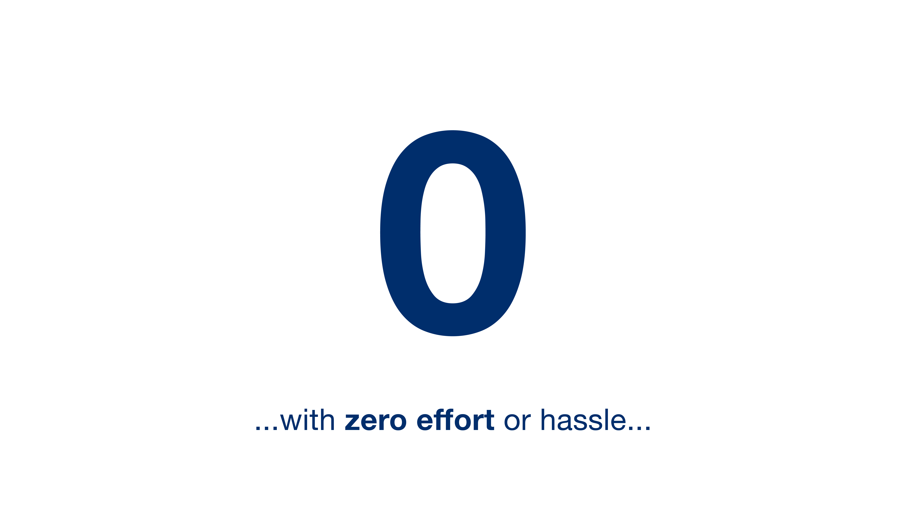
Storyboard
…any time you want,
with zero effort or hassle…
Slide to a clock ticking
Clock morphs into a zero

Slide 6


Storyboard
…so you spend less time finding information…
…and more time analysing
Cursor swipes along rows of documents
Zoom in on the aqua document, inside we are analysing the data, following the line with the camera and zooming

Slide 7
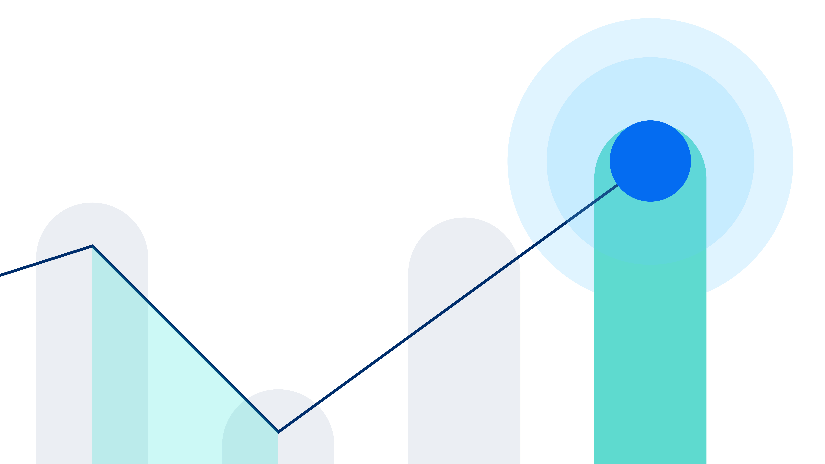
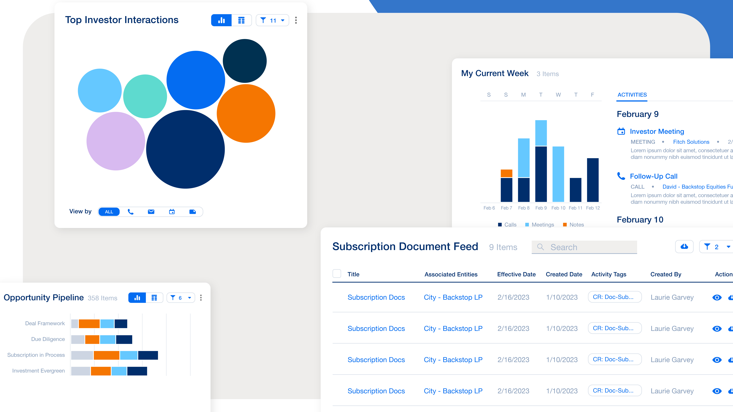
Storyboard
and acting on it…
…Imagine no more. Backstop Home Base makes critical information available to you…
Circles radiate out from the final point
Fast zoom right out. Different ‘panels’ are floating into frame as if we are moving backwards through them.

Slide 8
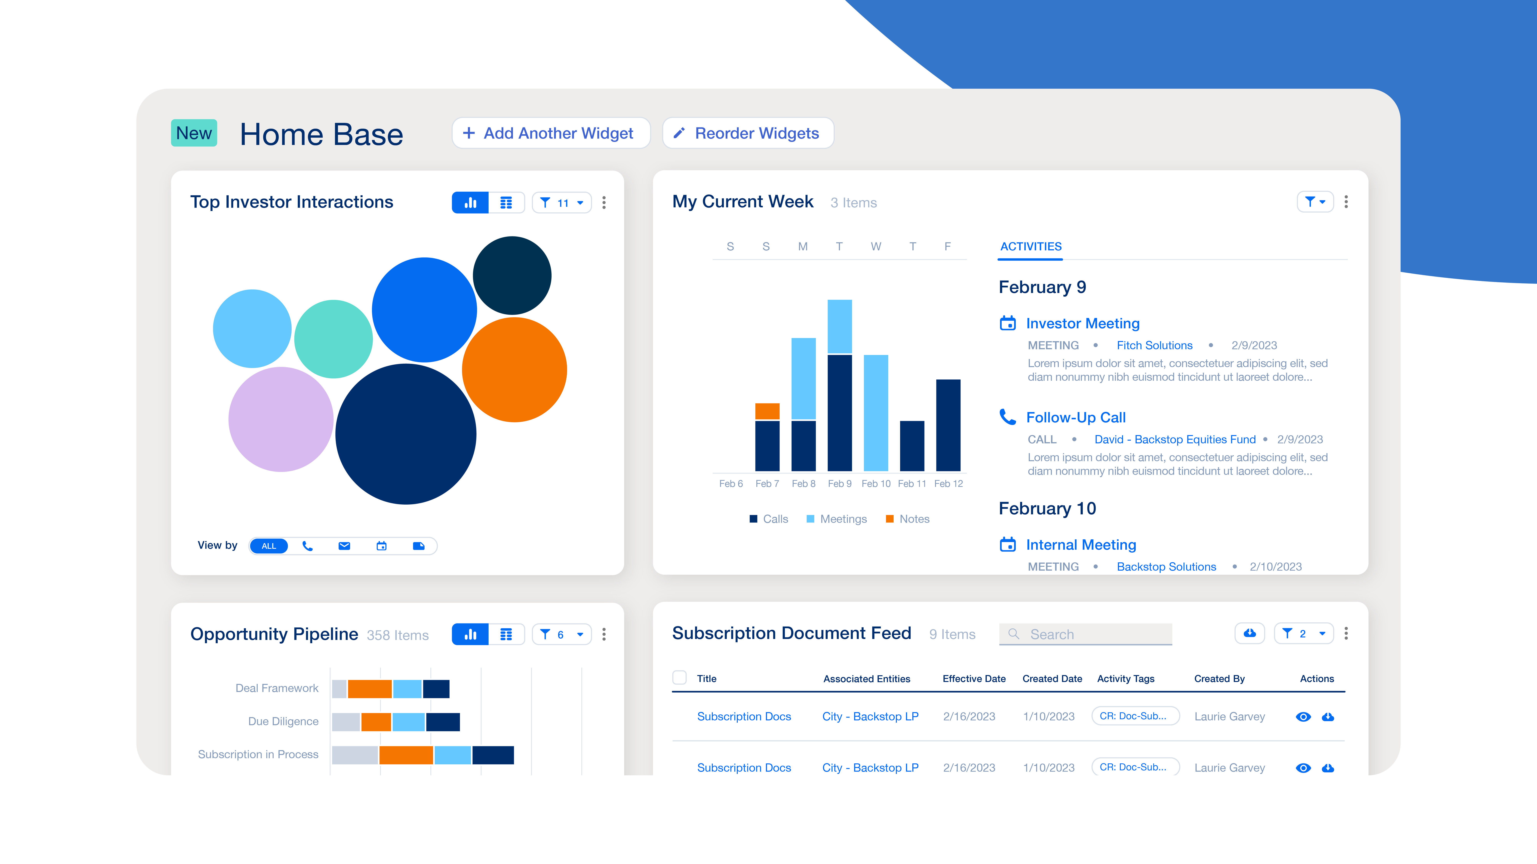
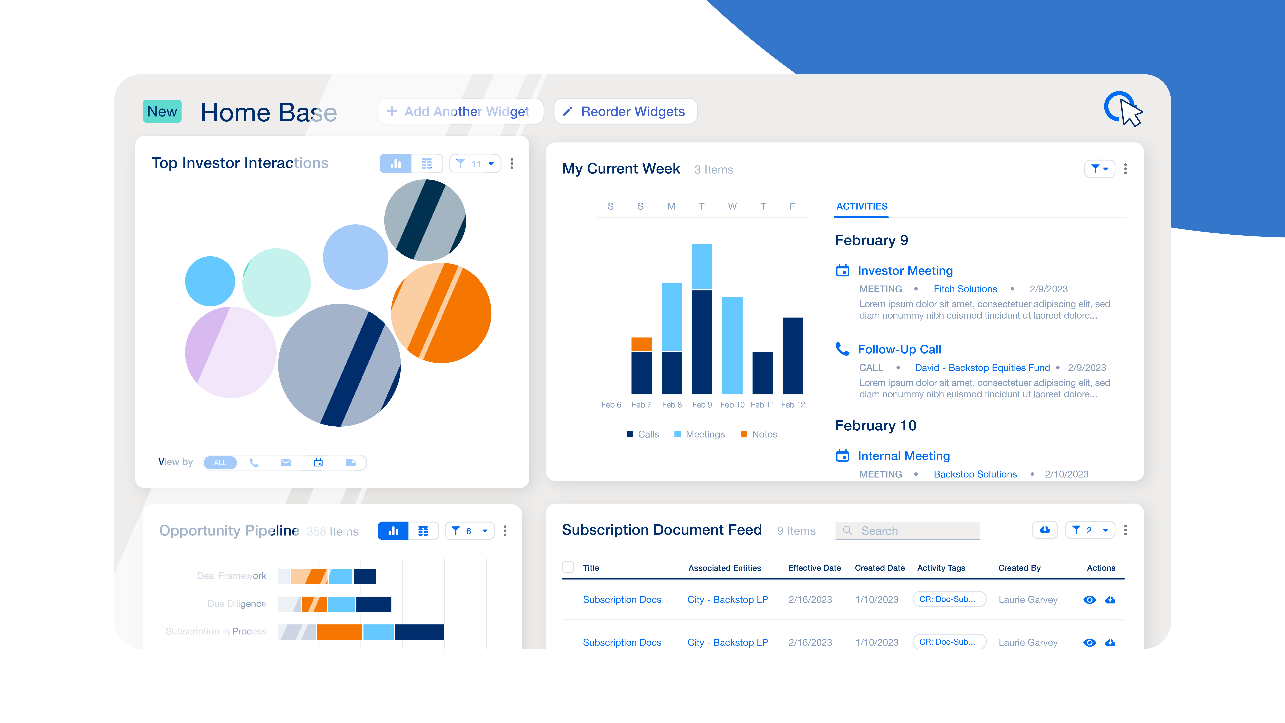
Storyboard
…in a dynamic, unified view…
…that’s updated with each refresh …
The panels all click into place
A shine slides over Homebase, mouse clicks top right corner

Slide 9
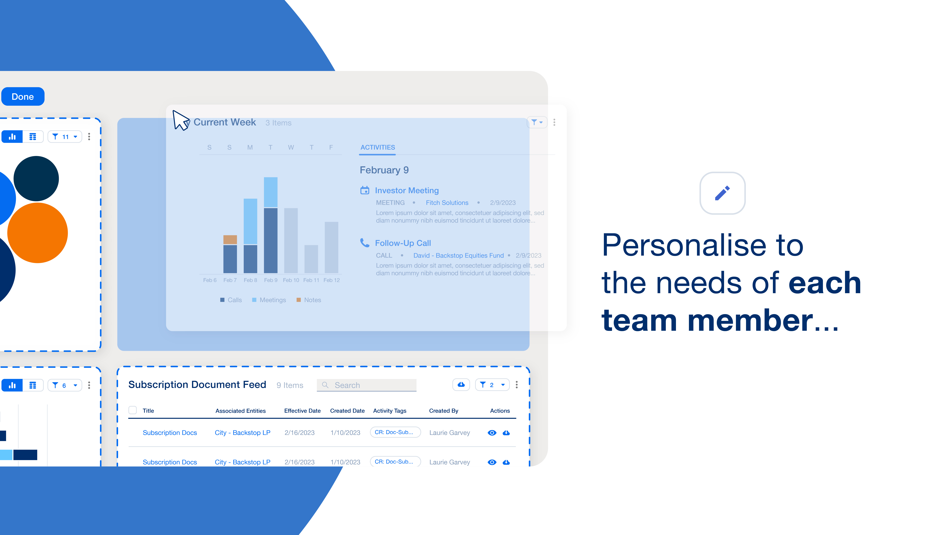
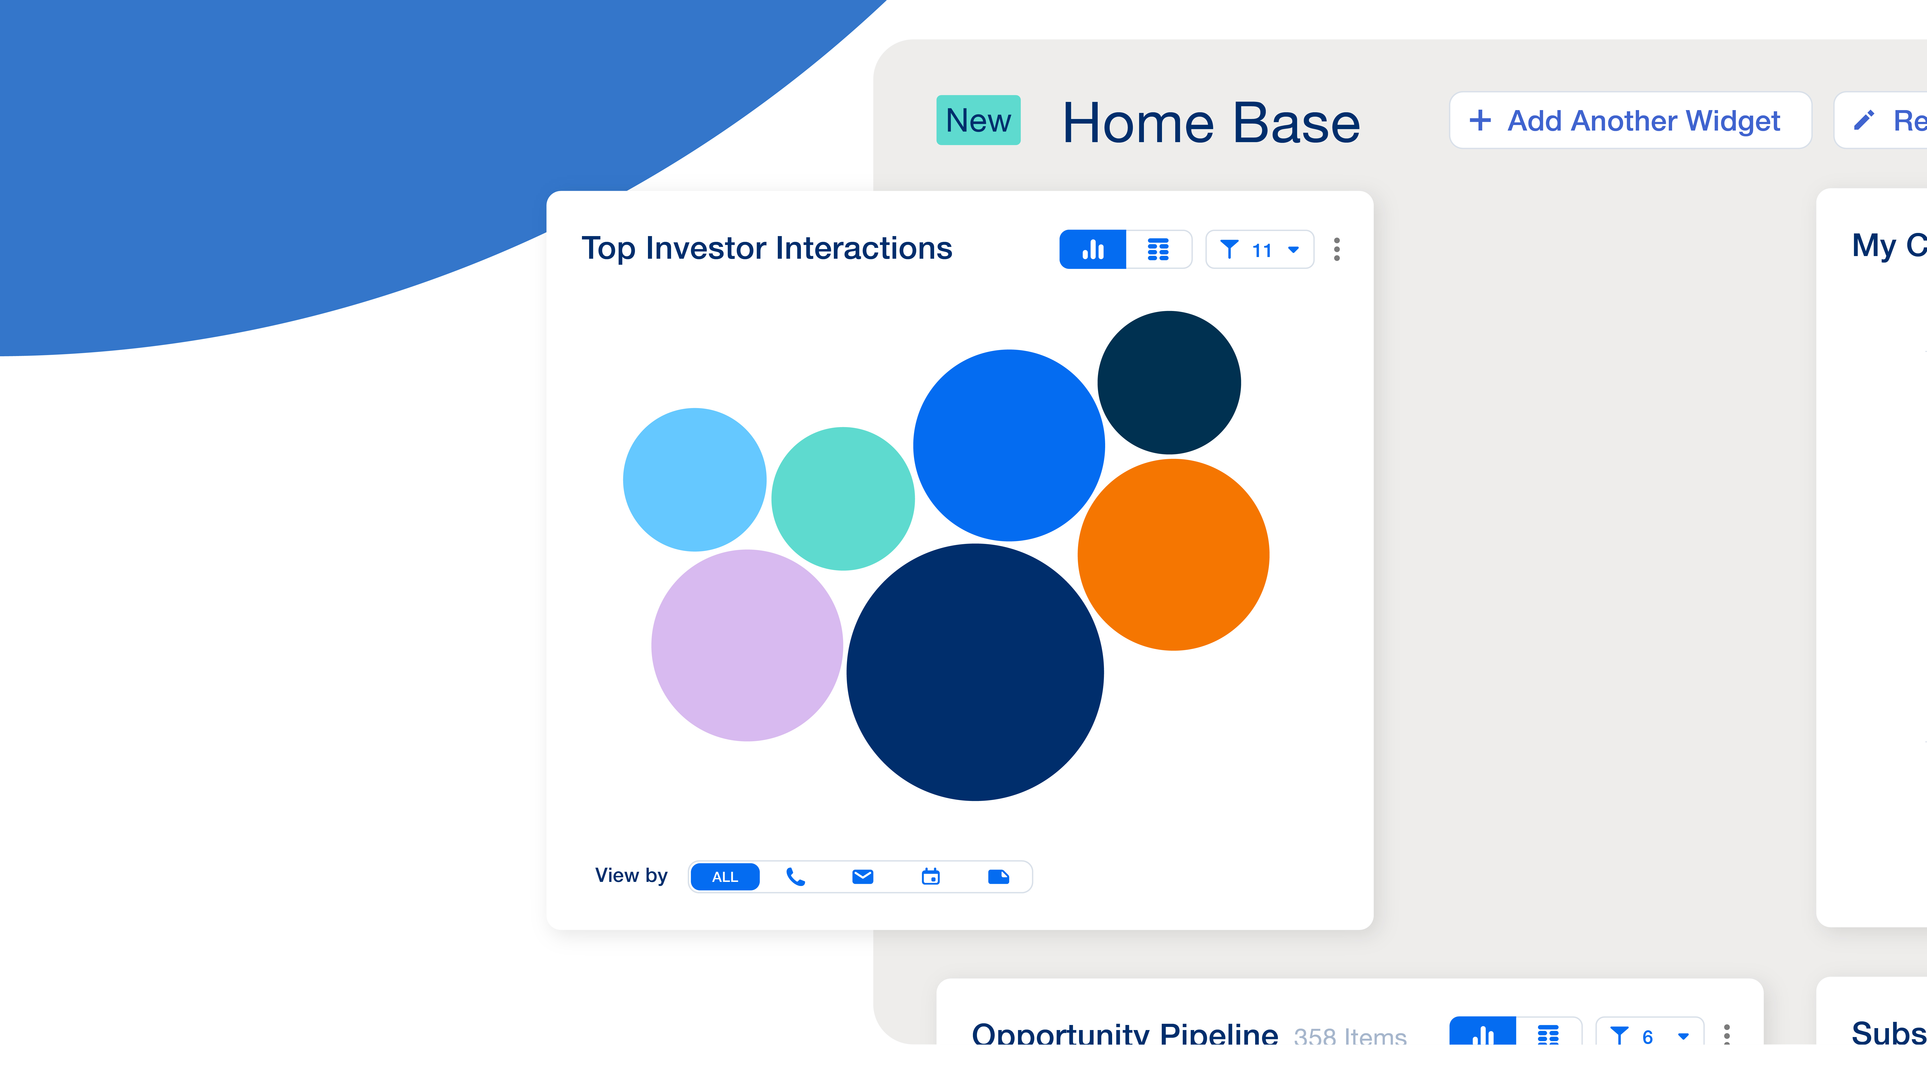
Storyboard
…and personalized to the needs of each team member.
Monitor your top investor interactions…
Mouse clicks and drags ‘widget’ off of homebase, it disappears with a whoosh, the document feed automatically moves up into it’s place
Transitioning to the left, the TII panel stay scentre, everything else slides off screen

Slide 10
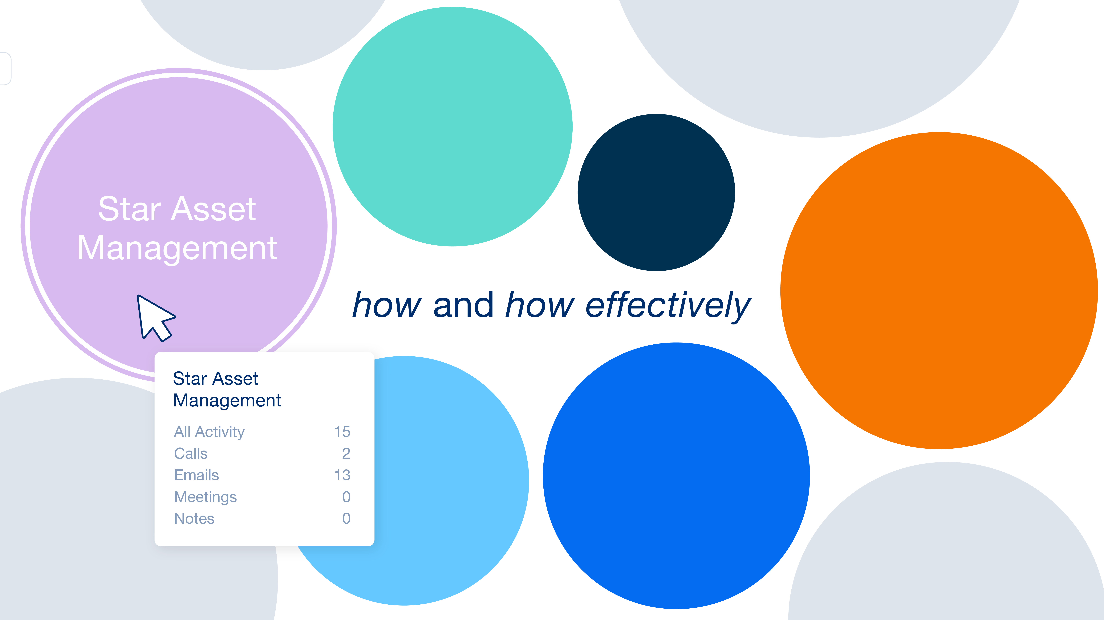
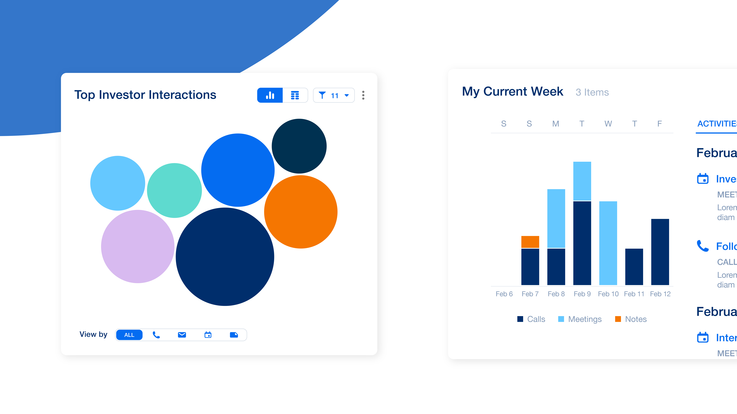
Storyboard
…to understand how - and how effectively…
… clients are being served …
Zoom right into panel, mouse clicks on purple circle, menu appears
Zoom out again to show the panel sliding away, replaced by the Meetings Panel.

Slide 11
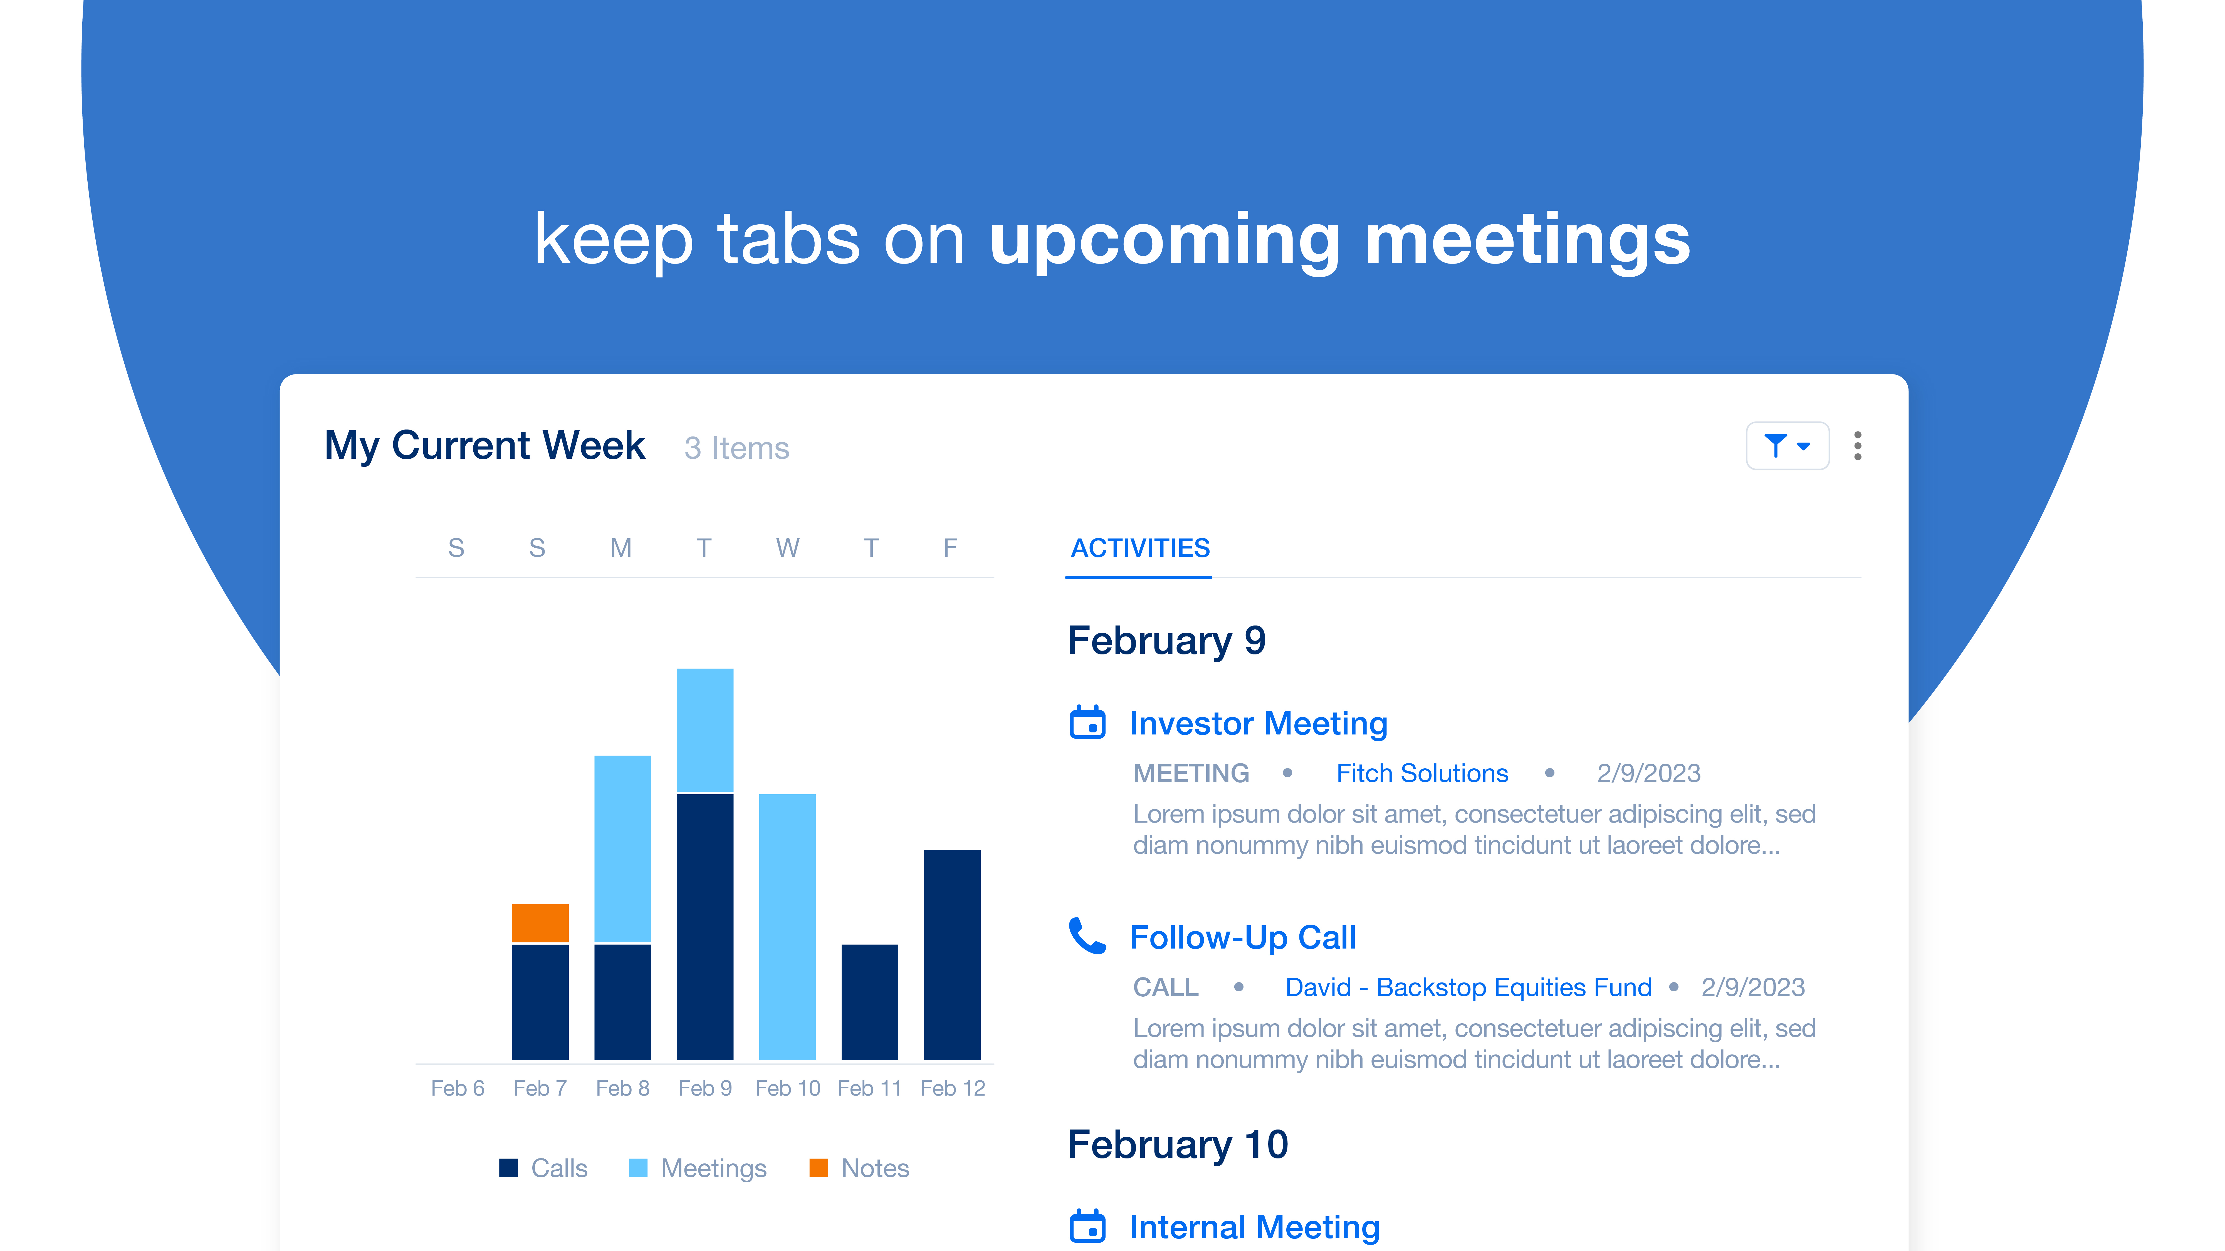
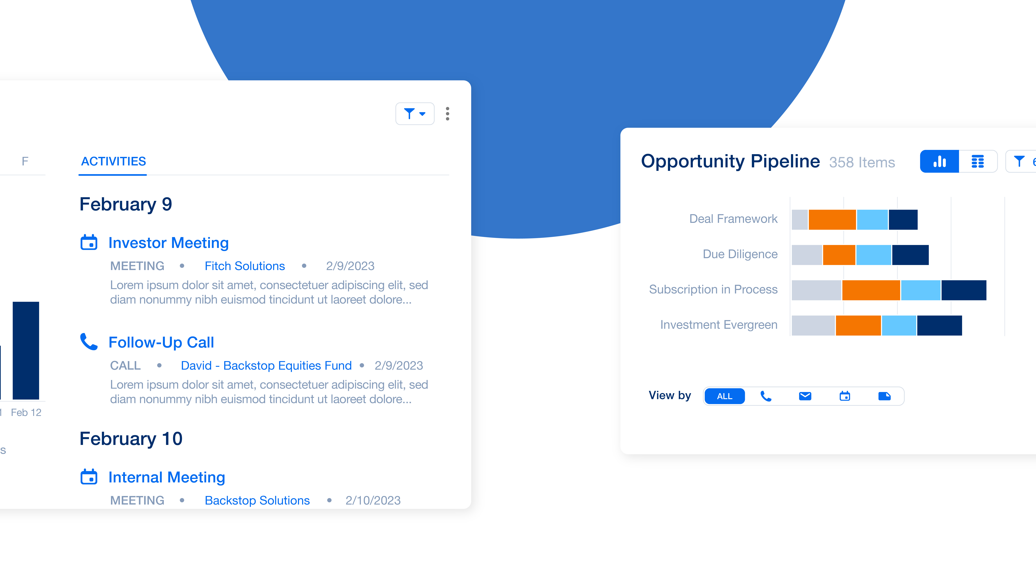
Storyboard
Keep tabs on recent and upcoming meetings.
Get a snapshot of your entire team’s opportunity pipeline…
Blue circle slides into centre, copy appears.
Zoom out again to show the next panel sliding in

Slide 12
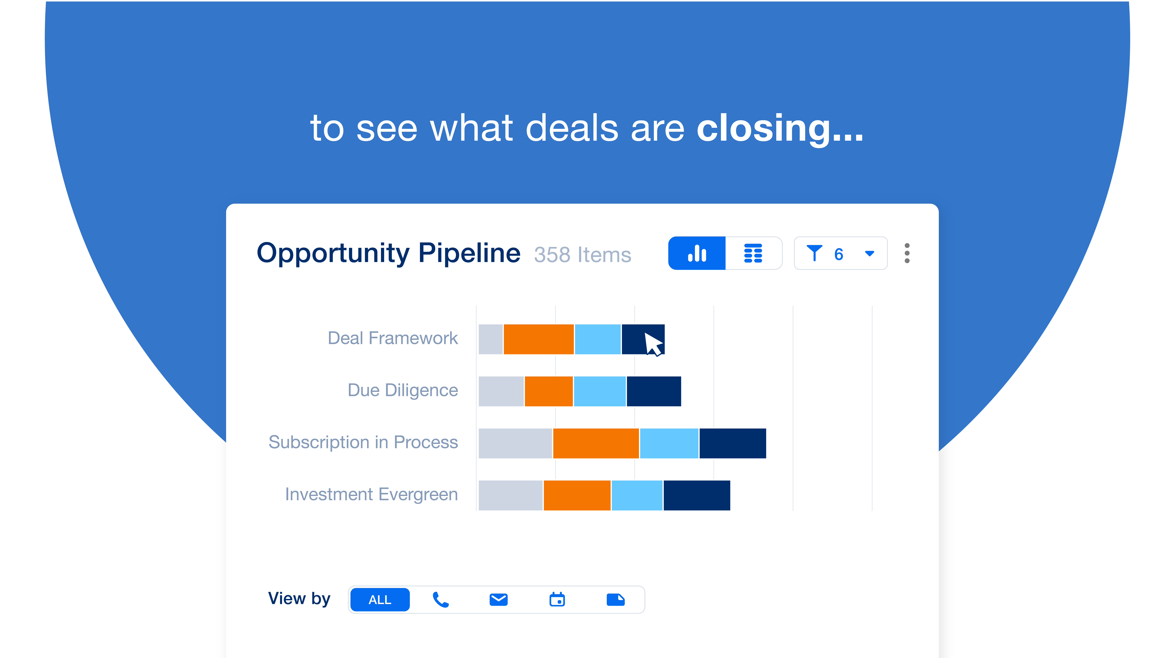
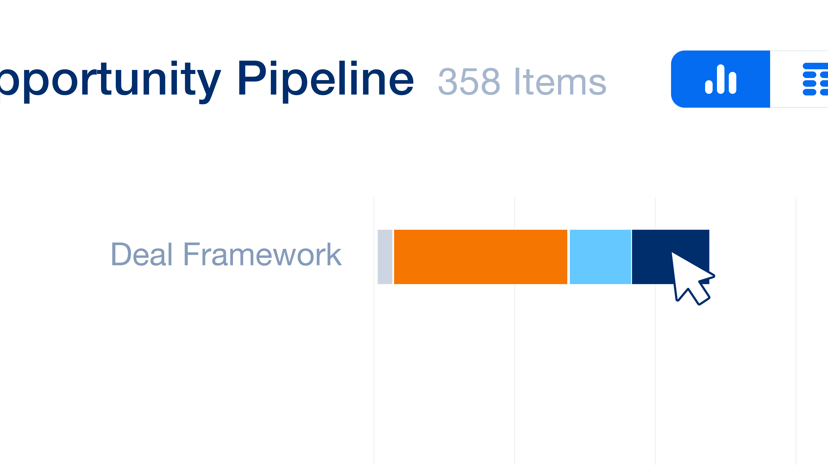
Storyboard
…to see what deals are closing…
…identify bottlenecks…
Mouse clicks on top bar
Zoom right in, orange bar is growing and squishing the other bars right down.

Slide 13
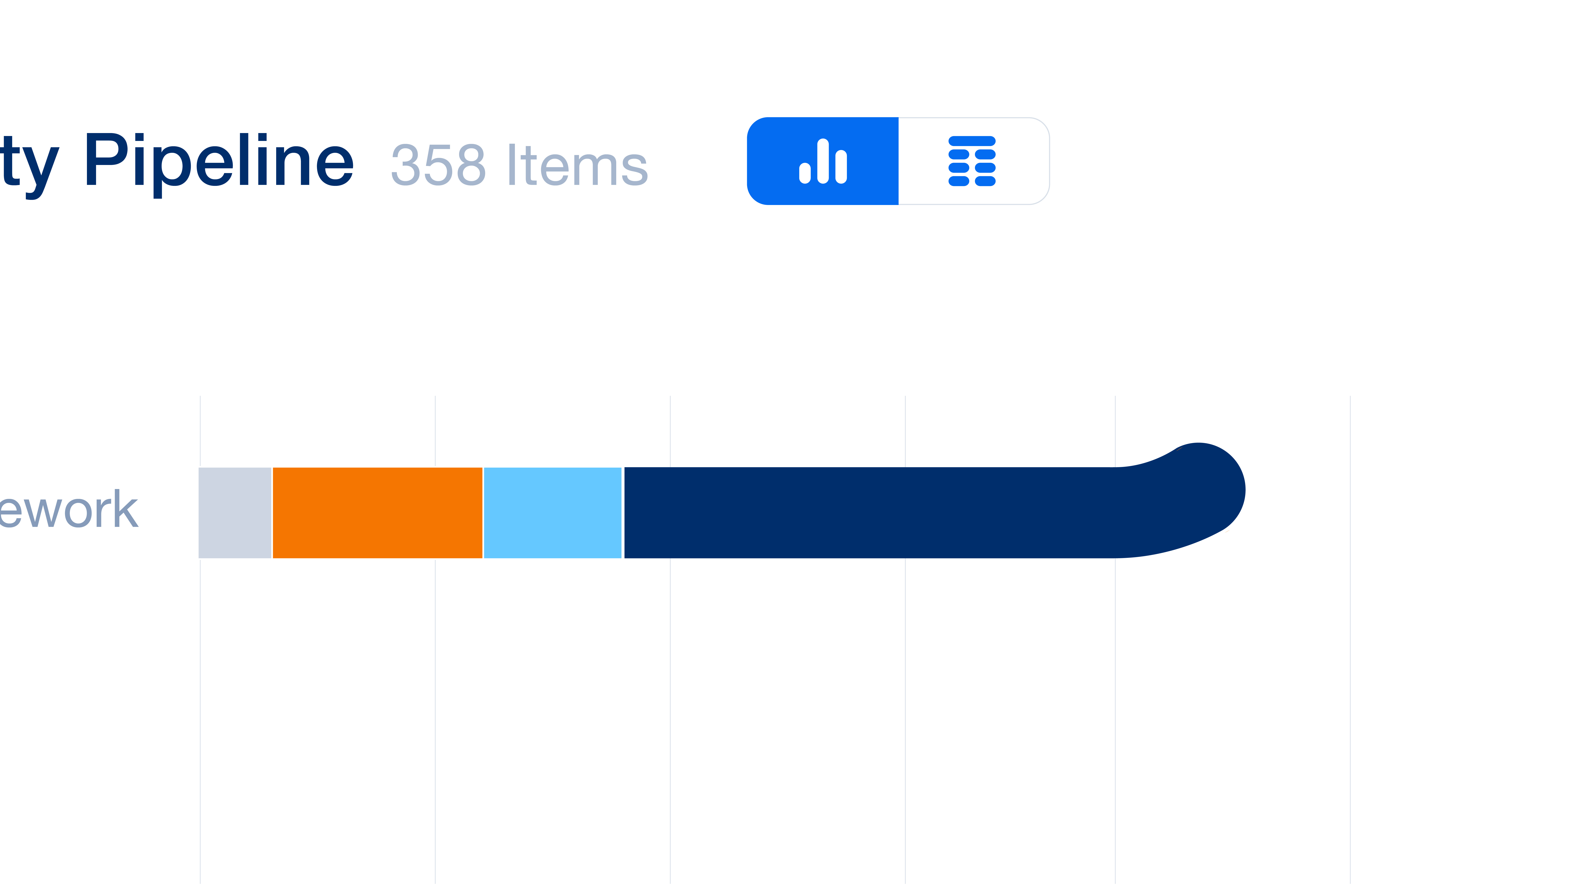

Storyboard
…and focus on closing the right prospects
at the right time.
Pan right, dark blue line extends from the end of the bar, whole graph stretches along. Camera follows as it curves…
…into a circle with a tick

Slide 14
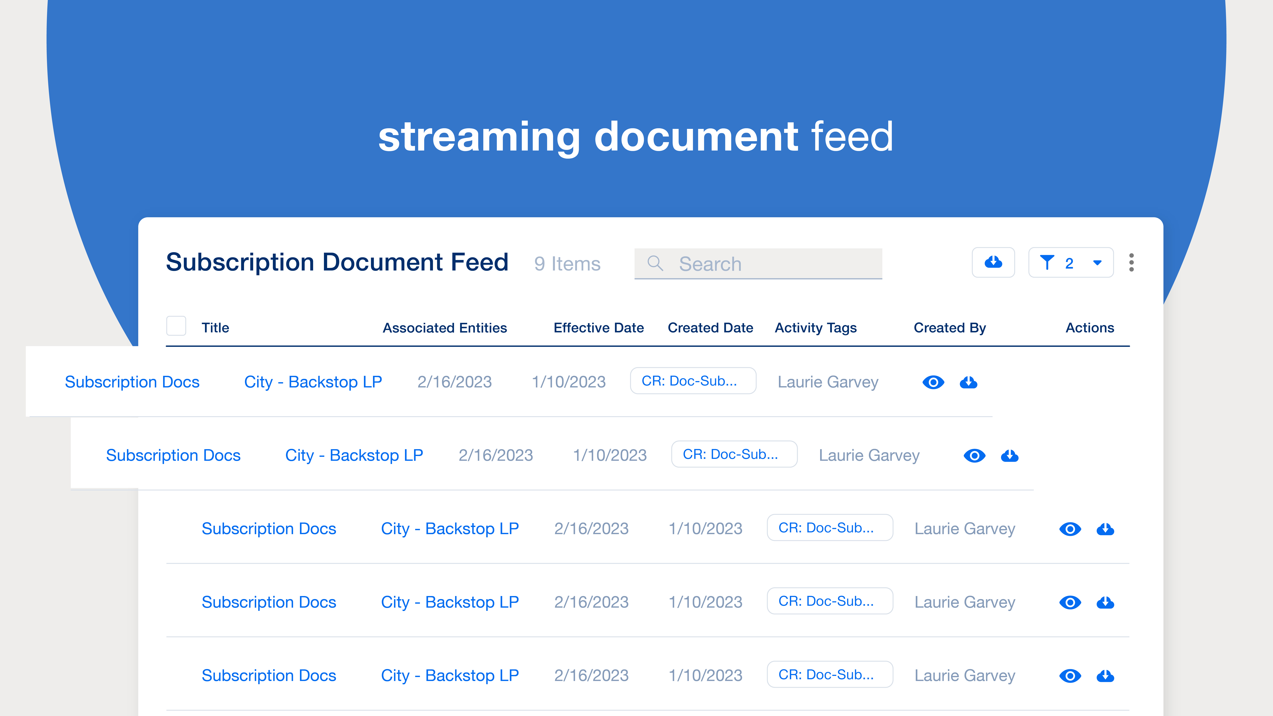
Storyboard
Looking for a subscription document?
…There it is, at your fingertips, in the streaming document feed…
Zoom right out the see all of homebase again.
zoom into document feed. Two more documents slide in at the top of the list, the rest shuffle down to make space.

Slide 15
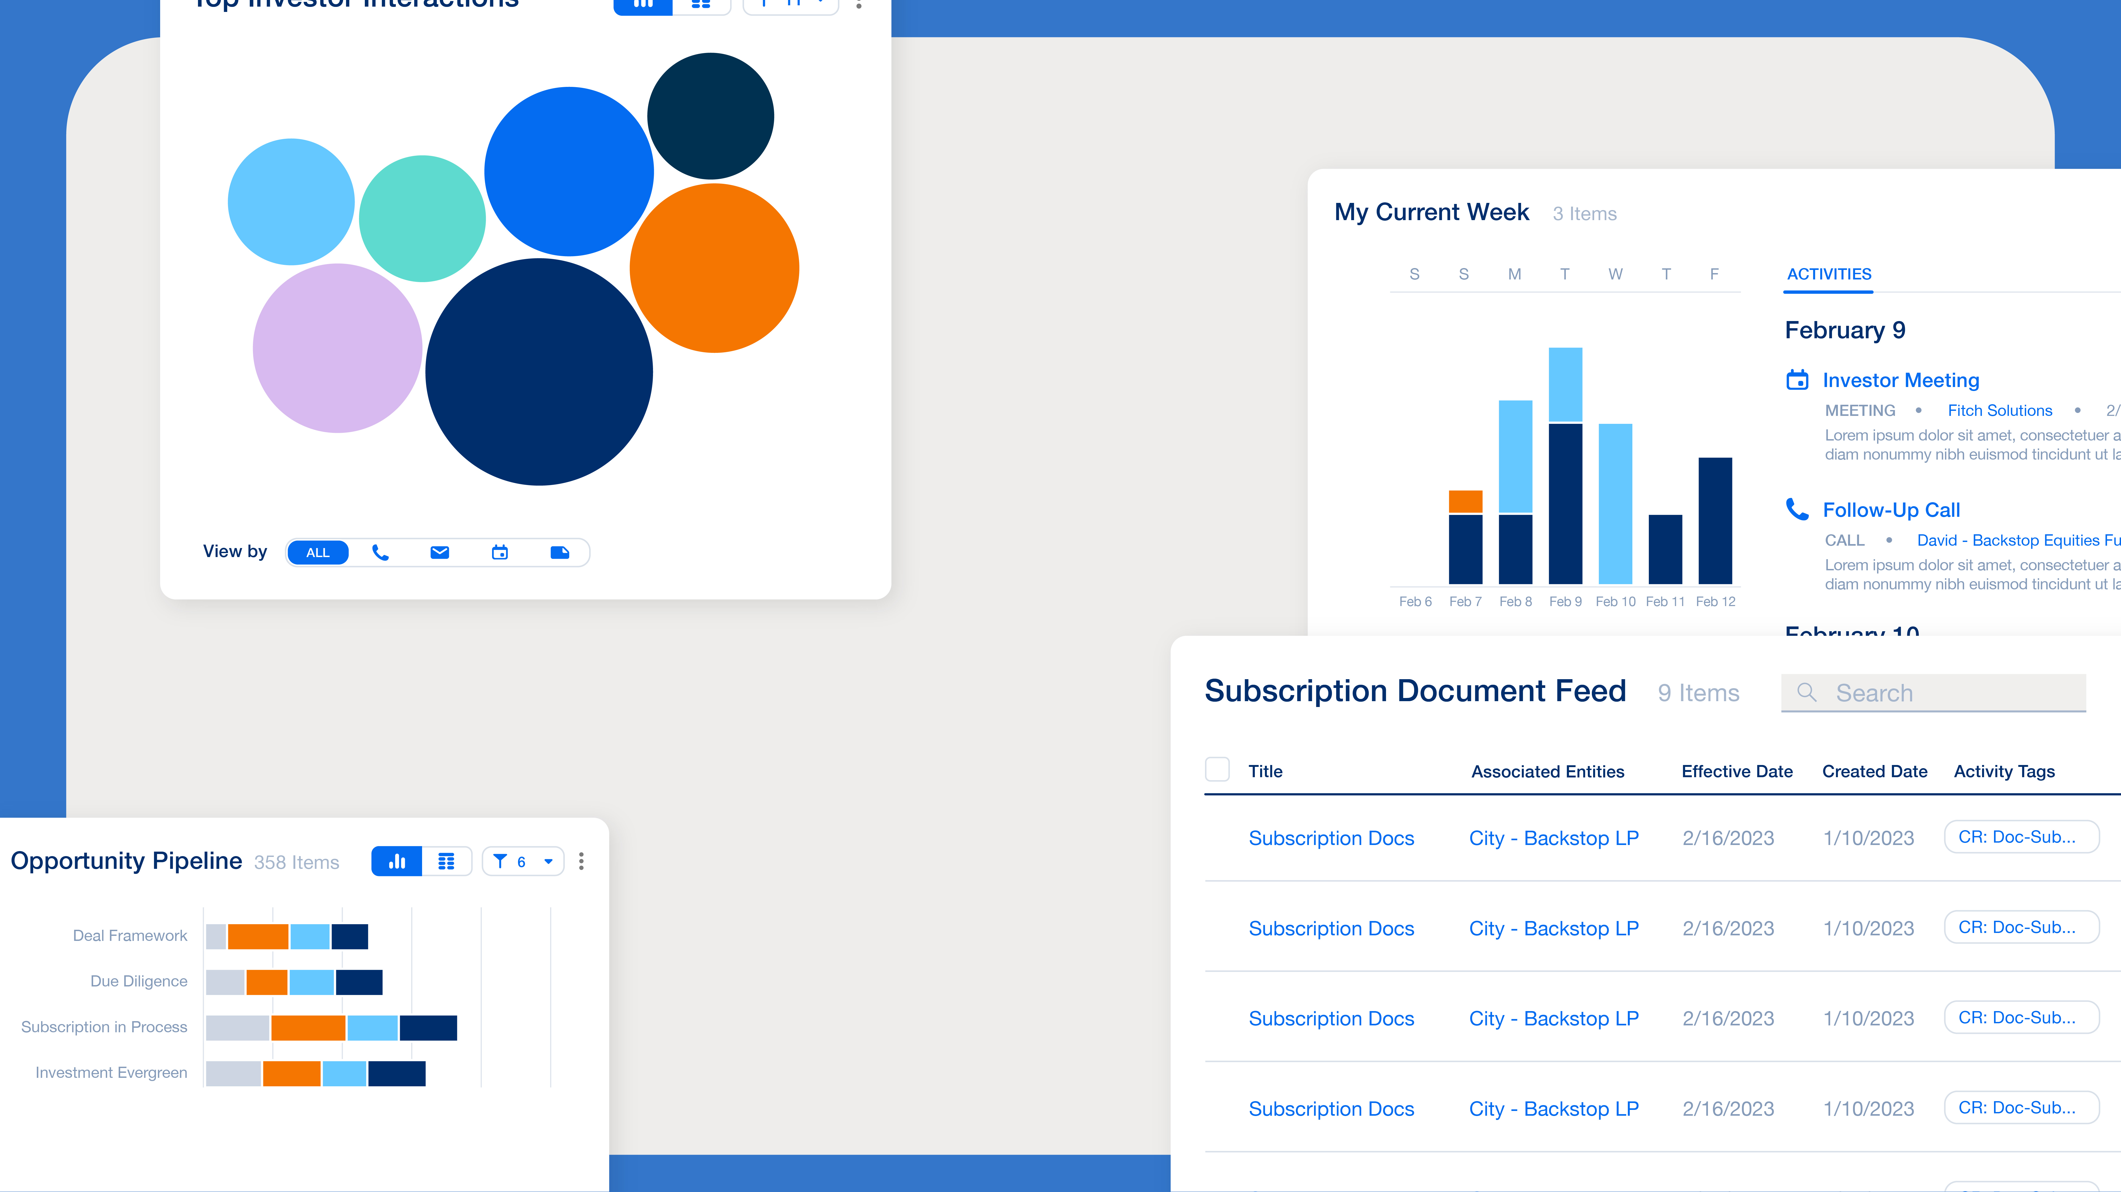
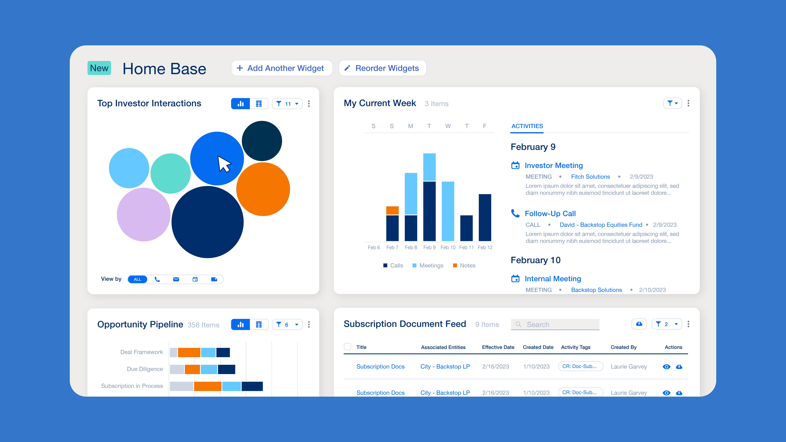
Storyboard
Everything you need…
is here in Backstop Home Base…
Slow zoom right out. Different ‘panels’ are floating into frame
Panels settle into place

Slide 16
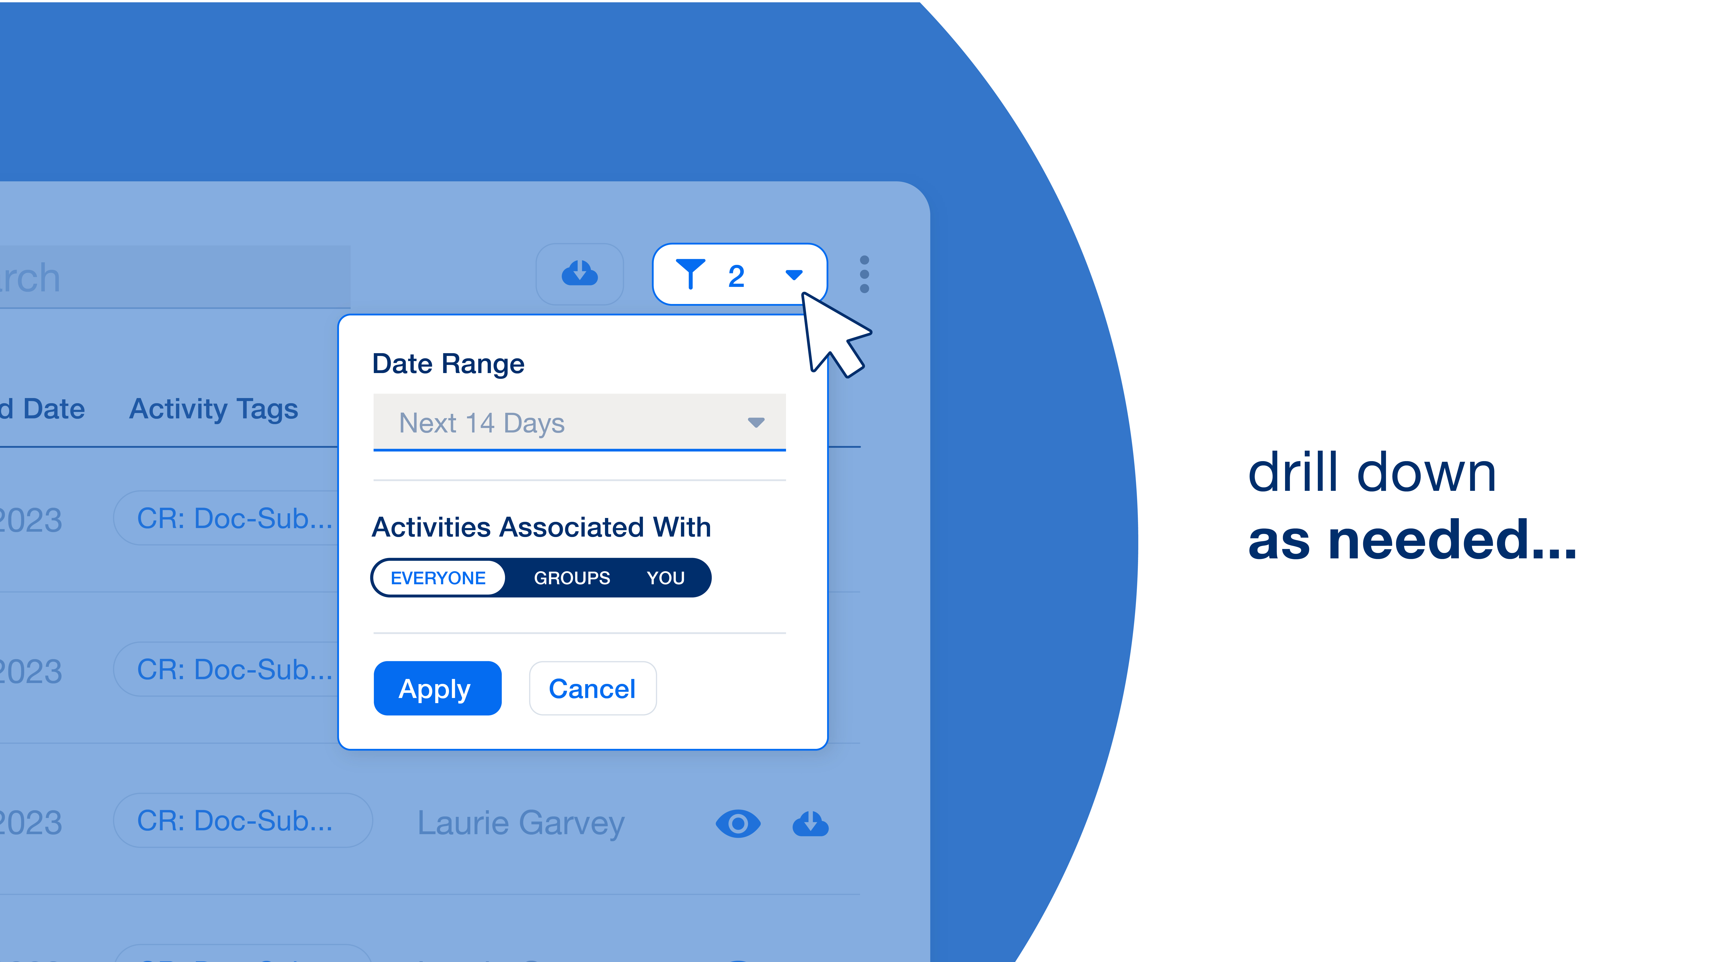

Storyboard
…with the option to drill down as needed.
…No need to request a report
Quickly zoom into document panel again, show the filter funciton
Slide to the right, document and bubble pop into place

Slide 17


Storyboard
or wait till your Monday meeting…
For a new way to start
Bubbles multiply and tick, the shift against each other like they are crammed into the screen.
Sun rises quickly from left of screen, at the centre of the screen we hear a click

Slide 18


Storyboard
And end your day…
…talk to us about Backstop Home Base.
The lights turn out, the sun becomes a moon with a few stars around. Moon sets.
(note: this is all happening quite quickly and snappy in time with the voice over)
Slide to the right, copy appears, homebase is underlined

Slide 19
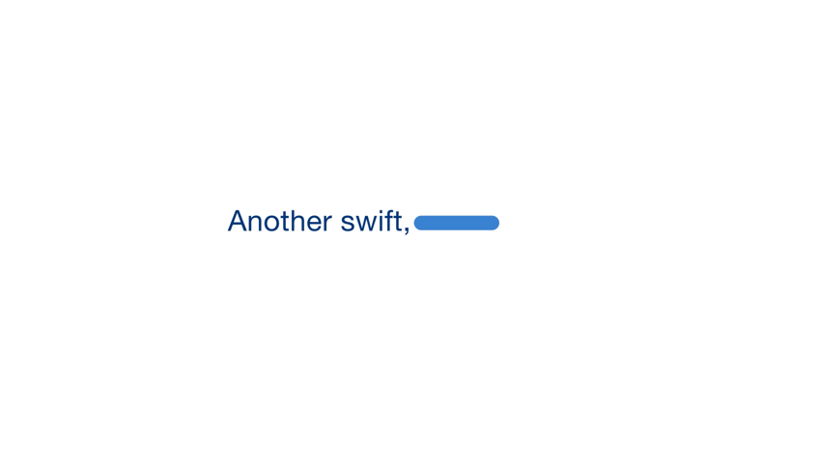
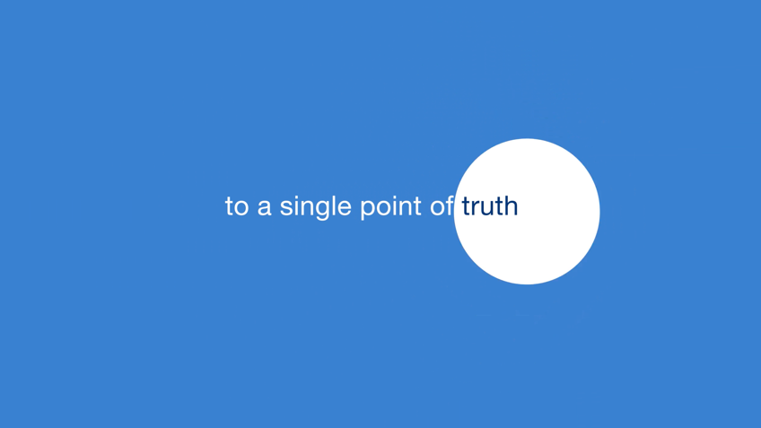
Storyboard
Another swift, simple route to a single point of truth…
a single point of truth…

Slide 20
Storyboard
…courtesy of Backstop Solutions.

