Slide 1
Citi Global Wealth
Citi Global Wealth
Global Marketing Team
Marketing Materials Request
February 2022
Strictly Private and Confidential

Slide 2
Purpose and Objective
As we assess the future state of how Citi Global Wealth appears to our prospects and clients, our first step is to review the Wealth creative assets across products and across the customer experience as they exist today.
The following pages are a template for each market to complete by no later than March 10.
To assist you, we have provided an example on Slides 7-11 of a U.S. Citigold “On Your Terms” campaign.
Please include examples of the following creative assets with planned live dates between Q3’21 and Q4’22 (if final produced assets are not yet available for upcoming work, please include ad lobs / mocks):
Paid Advertising
  TV (Linear, Advanced), Addressable (TV, Digital), OLV, CTV/OTT, OOH, Print, Audio, Display, Affiliates, Social, SEM (Paid Search, SEO), Content Programs
Owned (Digital)
  Social, Owned Digital Placements, Statements, Email, Direct Mail, Phone, Triggers, Push Notifications
Owned (In-Branch)
  ATM, Branch External Merchandising, Branch Interior Merchandising, Branch Collateral, Salesforce Tools, MMTO/Marketing Center, Branch Digital Screens, Servicing Letters, Welcome Kits
Owned (Events & Sponsorships)
  Experiential Events and Assets (assets that go into the event including pre and post assets), Sponsorship Activation Events, Sponsorship Assets (assets that go int the sponsorship activation including pre and post assets, Partner Assets (e.g. AA owned assets)
Priority Branding Elements
  Please indicate branding elements that are utilized in current work and whether they are important for upcoming work.

Slide 3
Win in Wealth, UK
DATE IN MARKET / PLAN TO BE IN MARKET
Q4’2021 - Present
PRODUCT VALUE PROPOSITION/FEATURES
Citigold builds wealth solutions that are based on your terms and unique goals. We need to demonstrate that with Citigold, you’re not alone in managing your wealth; you’re backed by the strength of our tools and our people’s expertise
PRIORITY AUDIENCE (e.g., Affluent, HNW)
Affluent & HNW individuals with an investor mindset & in-market for wealth solutions
KEY OFFER LANGAUGE (e.g. Earn up to £500 Cash Reward, 50,000 Avios Points or £500 on Harrods Reward card)
Enjoy a welcome reward of £500 when you join Citigold Wealth Management*
PAID MEDIA INVESTMENT Q3 AND Q4 ‘21 AND PLANNED MEDIA INVESTMENT FOR 2022
Q3 2021 | Q4 2021 | Planned 2022
Work Media Spends: $77,763 | Work Media Spends: $480,339 | Work Media Planned Budget: $400,000
Objective: Drive awareness and efficient site traffic as secondary KPIs | Objective: Continue to build Citigold awareness & drive efficient website visits to learn more about Citi’s wealth offerings | Objective: Continue to build Citigold awareness & drive efficient website visits to learn more about Citi’s wealth offerings
Channels: Social | Channels: Social, Podcast, OOH, Display | Channels: Social & Display
PERFORMANCE HIGHLIGHTS (e.g., brand lift, cpa, accounts opened during this period, AUM)
Q3 2021 | Q4 2021 | Planned 2022
Delivered 63% higher impressions with 22% times higher clicks and 3.5x views, which is surpassing the benchmarks on social | Apart from delivering the target impressions and 5x reach against benchmarks, we garnered 9 assisted conversions and 1 direct Citigold account open. OOH successfully increased organic searches for the brand in the surrounding areas of screen-locations | Campaigns Ongoing
3

Slide 4
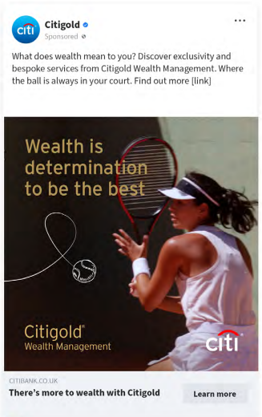
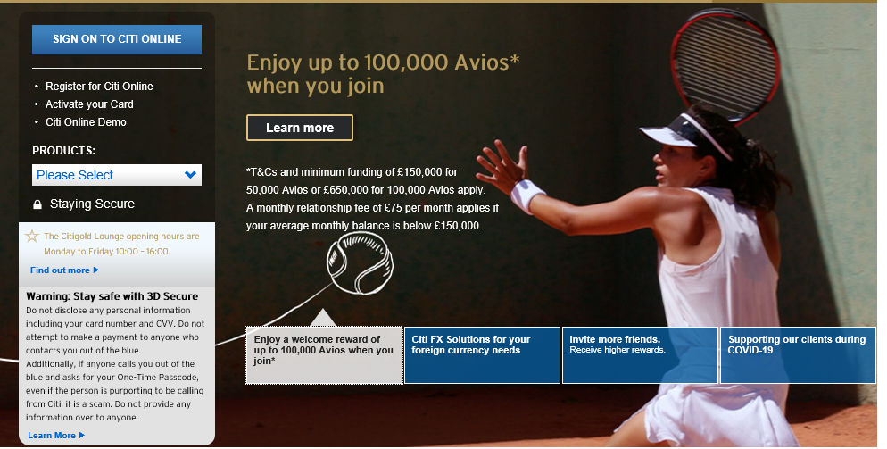
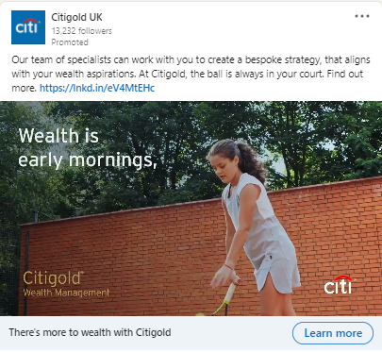
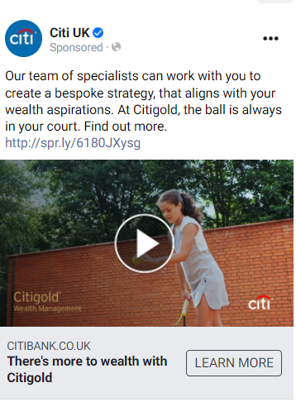
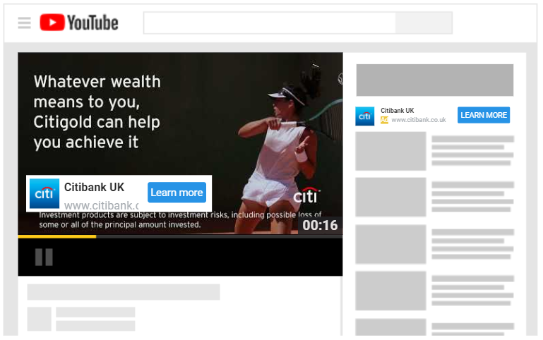
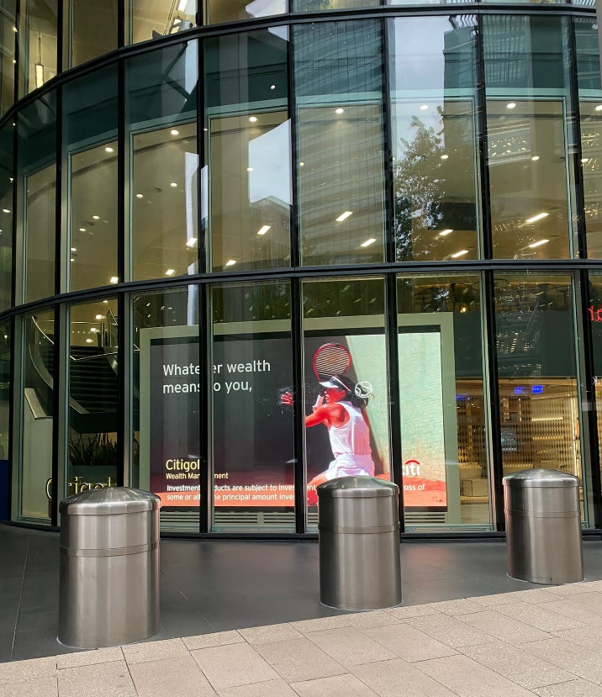
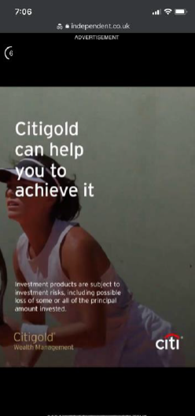
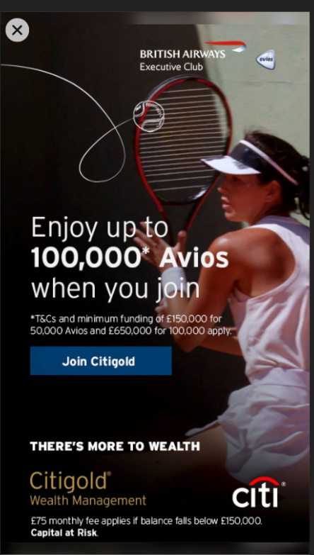
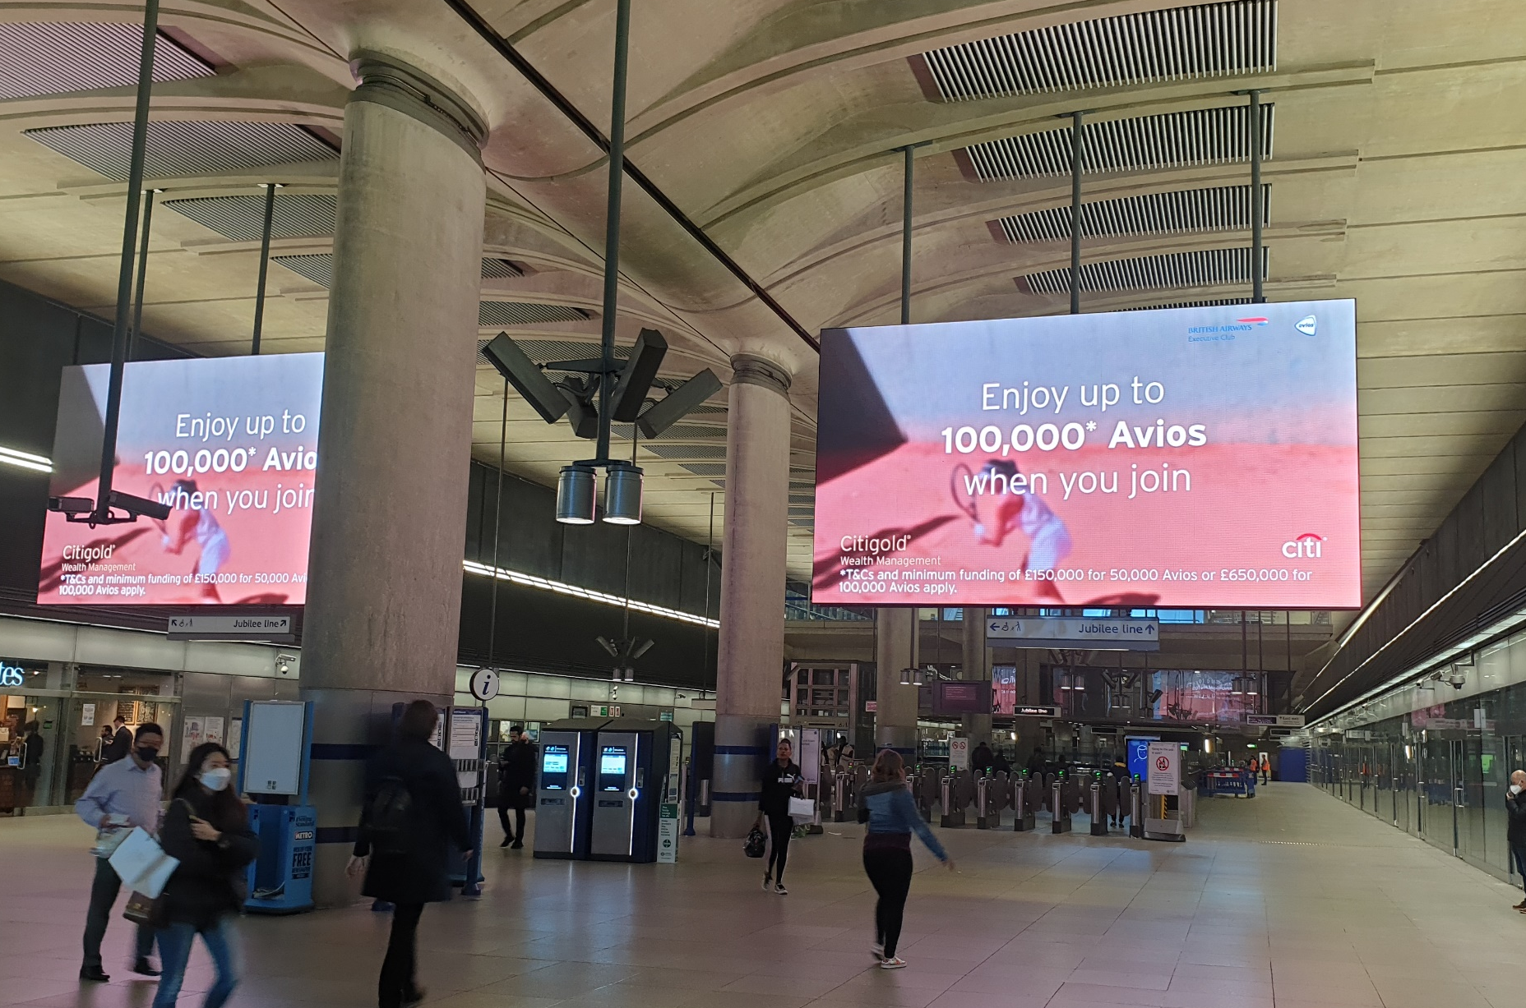
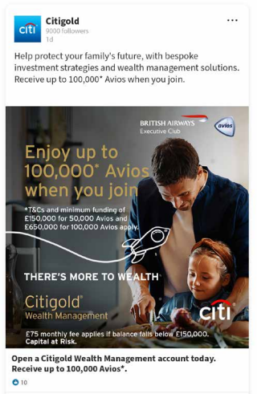
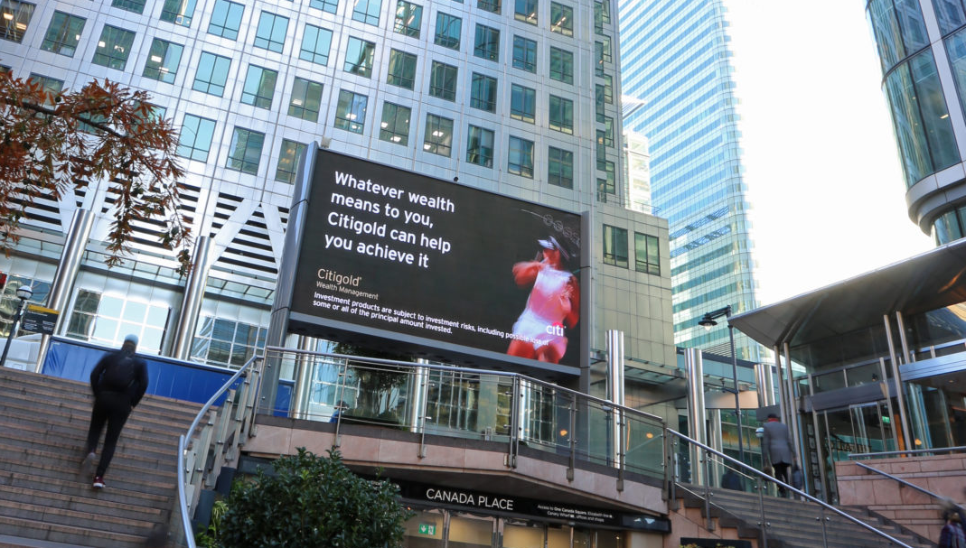
There’s More To Wealth, UK
PAID ADVERTISING
TV (Linear, Advanced), Addressable (TV, Digital), OLV, CTV/OTT, OOH, Print, Audio, Display, Affiliates, Social, SEM (Paid Search, SEO), Content Programs
OWNED (DIGITAL)
Social, Owned Digital Placements, Statements, Email, Direct Mail, Phone, Triggers, Push Notifications
Landing page
LinkedIn
Facebook
YouTube
Digital - Mobkoi
Digital - Ogury
Social
OOH
Lounge Facade
4

Slide 5
There’s More To Wealth, UK
OWNED (IN BRANCH)
ATM, Branch External Merchandising, Branch Interior Merchandising, Branch Collateral, Salesforce Tools, MMTO/Marketing Center, Branch Digital Screens, Servicing Letters, Welcome Kits
OWNED (EVENTS & SPONSORSHIPS)
  Experiential Events and Assets (assets that go into the event including pre and post assets), Sponsorship Activation Events, Sponsorship Assets (assets that go int the sponsorship activation including pre and post assets, Partner Assets (e.g., AA owned assets)
5

Slide 6
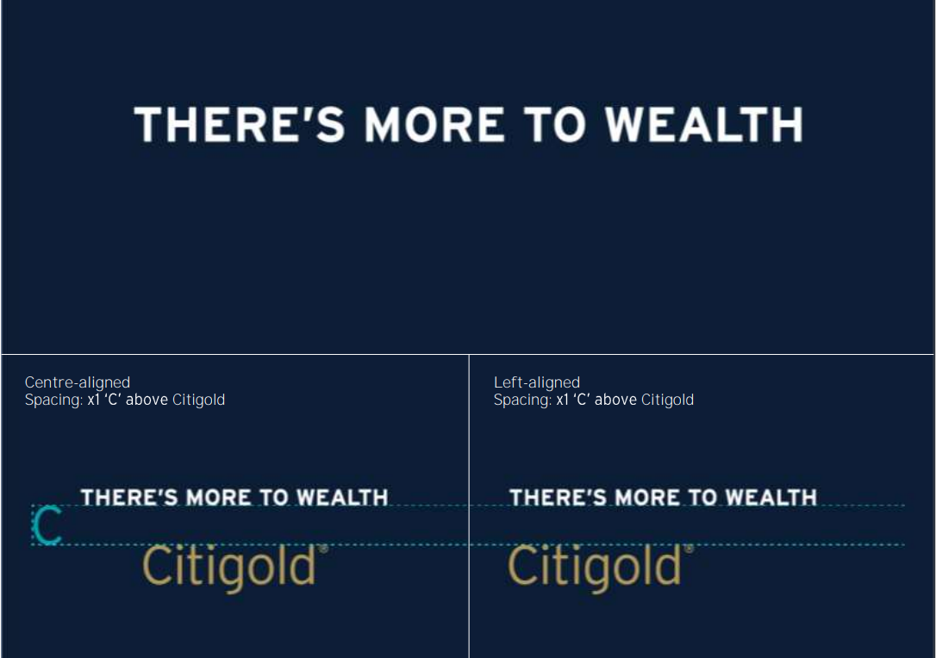
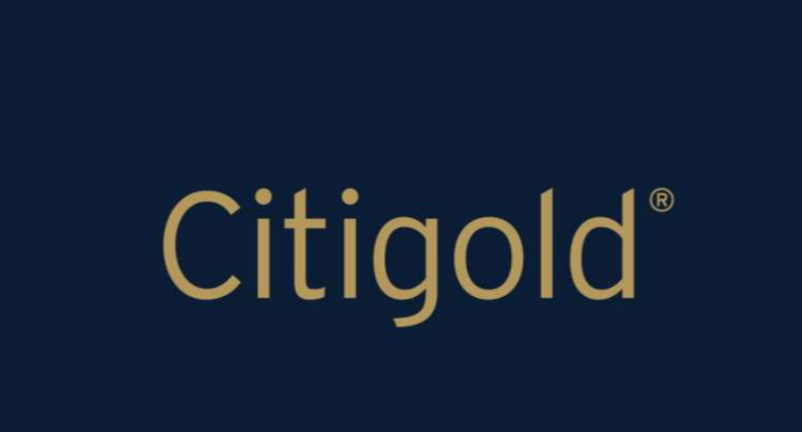
There’s More To Wealth, UK
HIGHLIGHT PRIORITY BRANDING ELEMENTS
Please indicate Citi and product branding elements that are utilized in current work and whether they are important for upcoming work.
Citigold logo The Citigold logo should be used clearly on every communication. The latest expression of the logo has a flat gold colour. The only time any gradient should be visible is on moving communications, when a sheen can run swiftly across the logo. Always use the Citigold logo asset with the ‘Registered’ symbol.
Try to avoid using the logo over busy/cluttered visuals to ensure it remains clear and visible
Colour values of logo:
#BE9E55 R181 G153 B92 C32 M37 Y58 K16
Campaign theme (TMTW) has been created as a carefully kerned standardized piece of typography. It can be used with the Citigold logo to sign-off a communication, however it should not be considered a lockup. Follow the guides to the right for correct spacing between the two elements.
The campaign theme should always appear in white over dark backgrounds, do not change to a colour
6

Slide 7
See Example of U.S. Citigold “On Your Terms”

Slide 8
Citigold “On Your Terms”, U.S.
DATE IN MARKET / PLAN TO BE IN MARKET
Q4’19 - Present
PRODUCT VALUE PROPOSITION/FEATURES
Citigold builds wealth solutions that are based on your terms and unique goals. We need to demonstrate that with Citigold, you’re not alone in managing your wealth; you’re backed by the strength of our tools and our people’s expertise
PRIORITY AUDIENCE (e.g., Affluent, HNW)
Affluent & HNW individuals (IXI: $200-$10MM) with an investor mindset & in-market for wealth solutions
KEY OFFER LANGAUGE (e.g. Earn up to $1,500 with qualifying activities)
Start a new relationship and earn a cash bonus for completing required activities, up to $1,500.
PAID MEDIA INVESTMENT Q3 AND Q4 ‘21 AND PLANNED MEDIA INVESTMENT FOR 2022
Q3 2021 | Q4 2021 | Planned 2022
Work Media Spend: $3.147M | Working Media Spend: $4.826M (Digital) + $3.278M (Local TV) | Working Media Spend: ~$30M
Objective: Garner incremental account approvals while continuing to drive awareness and efficient site traffic as secondary KPIs | Objective: MTA CPA for Digital; Lift in Awareness for Local TV | Objective: Continue to build Citigold awareness & drive efficient website visits to learn more about Citi’s wealth offerings
Channels: OLV, Display, Print | Channels: TV, OLV, Display, Print, Paid Search | Channels: OLV, Display, Print, Paid Search
PERFORMANCE HIGHLIGHTS (e.g., brand lift, cpa, accounts opened during this period, AUM)
Q3 2021 | Q4 2021 | Planned 2022
Q3 Brand Awareness lift came in at +15.4ppt and Message Association lift at +12.6ppt, both surpassing the +5ppt and +3ppt respective benchmarks. Campaign CPPV was highly efficient coming in lower than the $5.00 benchmark at $2.55 | The Q4 Citigold campaign garnered 447 halo approvals (109 of which are Citigold accounts). Campaign CPPV was highly efficient coming in lower than the $5.00 benchmark at $2.39. | Not yet available.
8

Slide 9
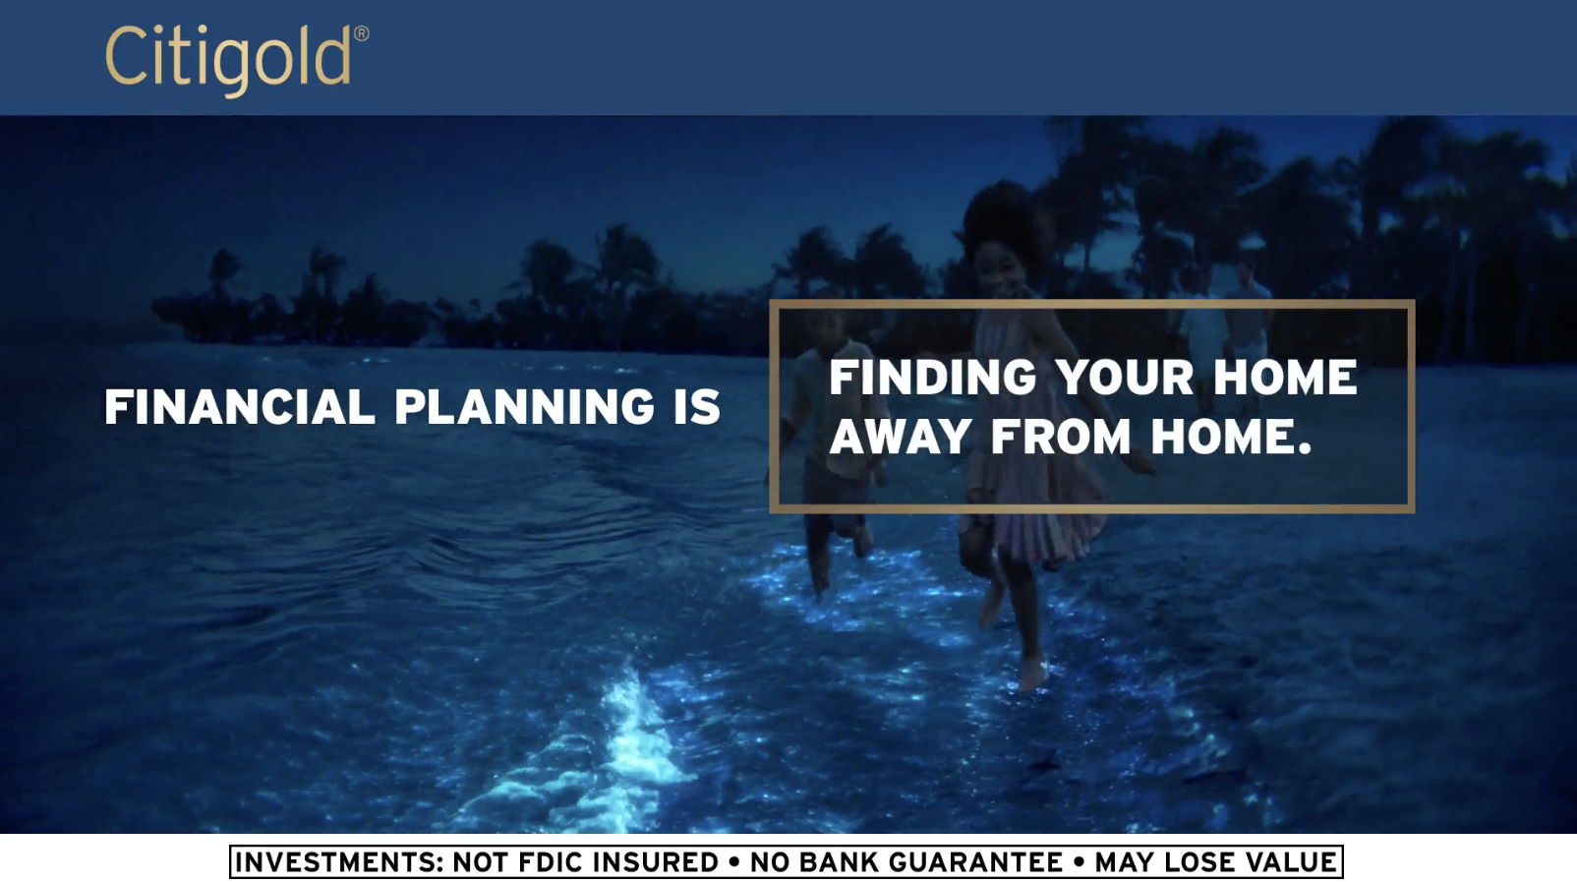
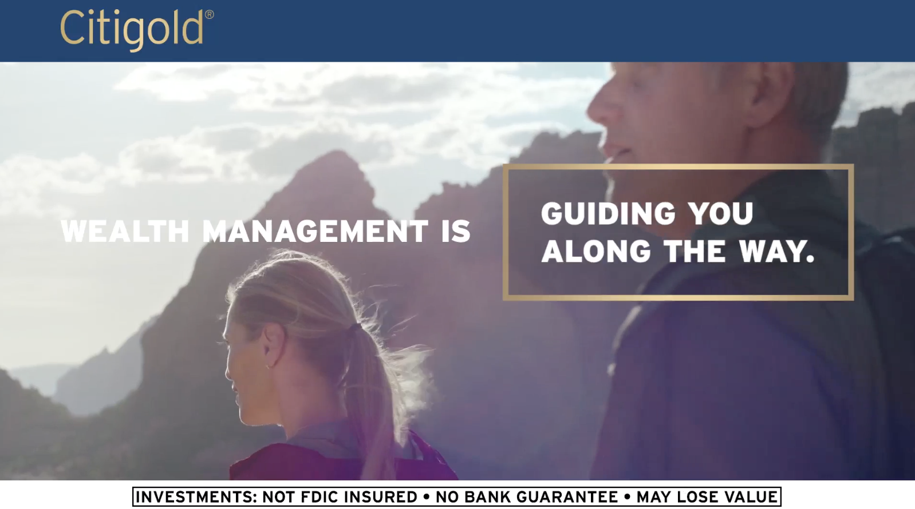
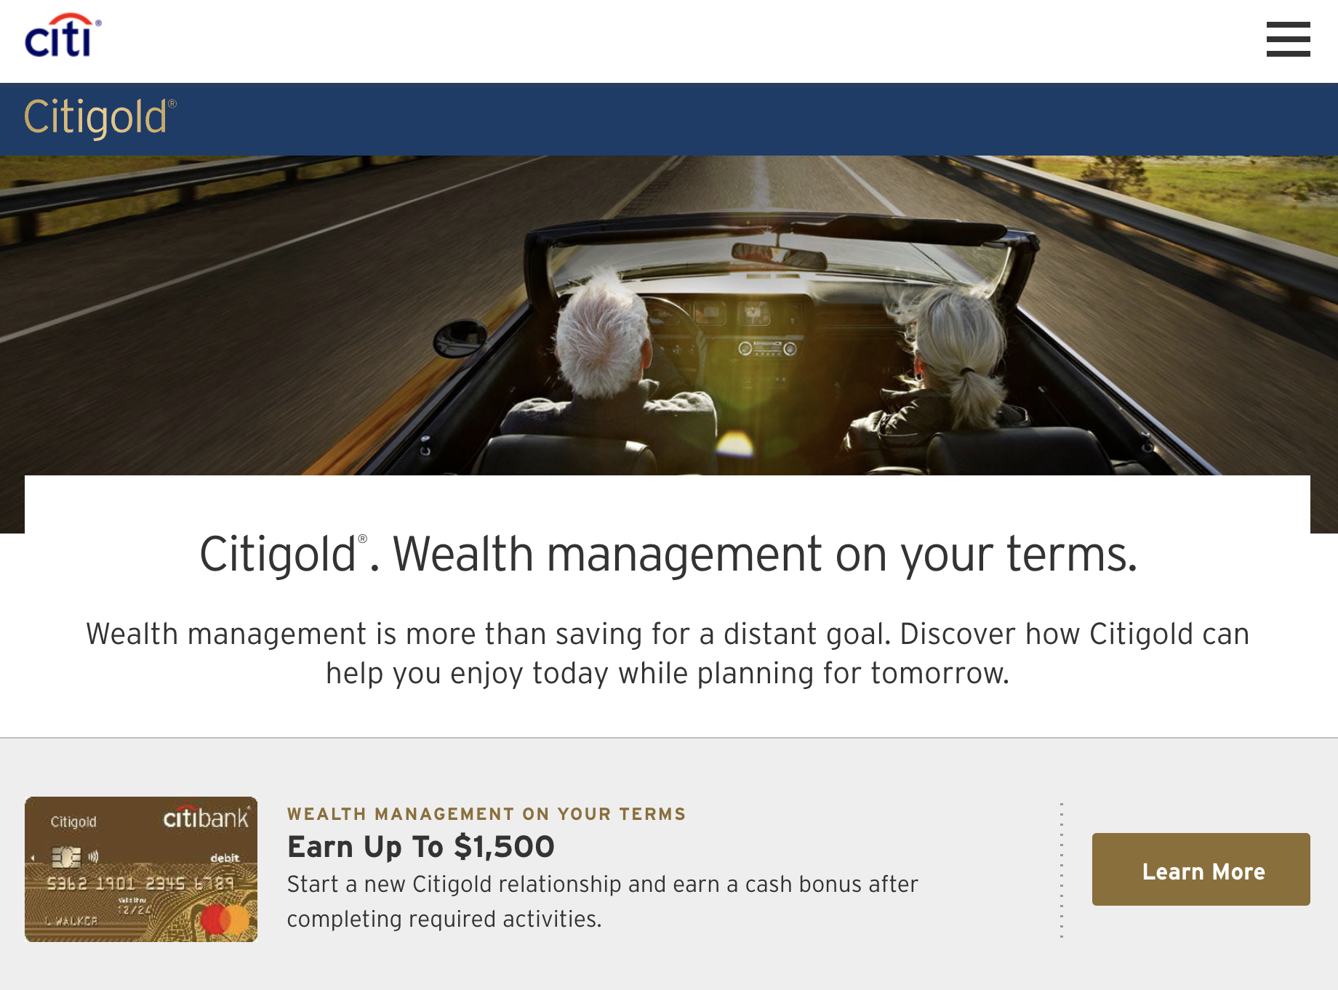
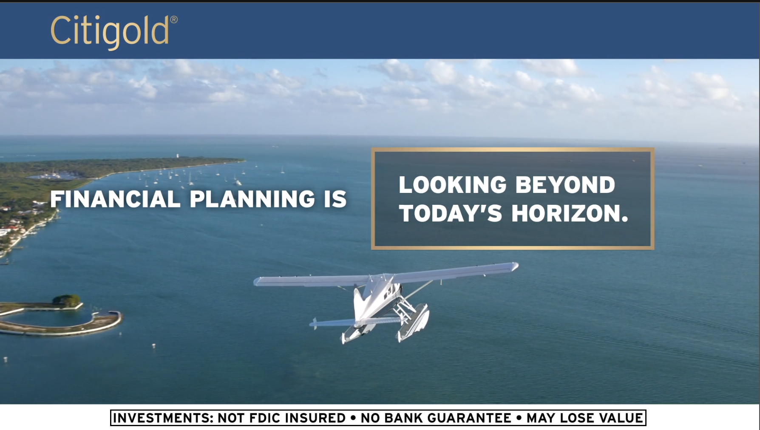
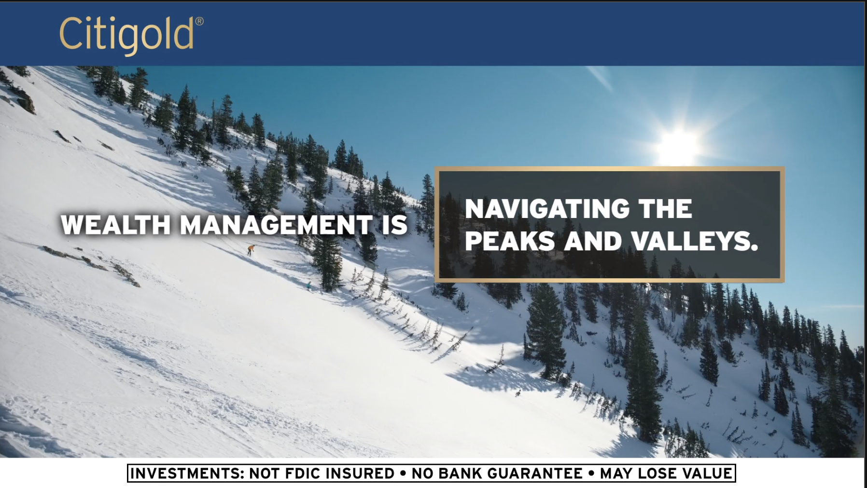
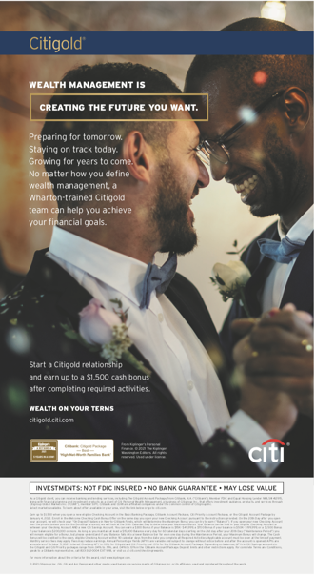
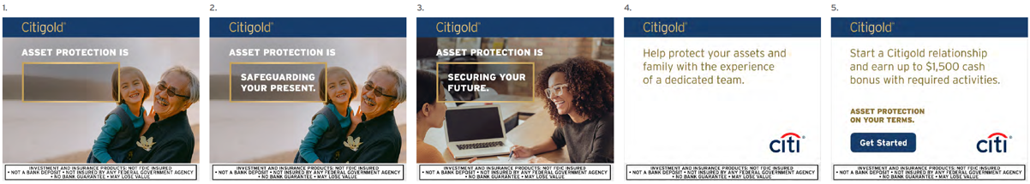
Citigold “On Your Terms”, U.S.
PAID ADVERTISING
TV (Linear, Advanced), Addressable (TV, Digital), OLV, CTV/OTT, OOH, Print, Audio, Display, Affiliates, Social, SEM (Paid Search, SEO), Content Programs
OWNED (DIGITAL)
Social, Owned Digital Placements, Statements, Email, Direct Mail, Phone, Triggers, Push Notifications
OLV – “Glow”
Live: Q4’19 – Q1’22
OLV – “Hike”
Live: Q4’19 – Q1’22
OLV – “Altitude”
Live: Q1’22
OLV – “Navigate”
Live: Q1’22
Landing Page
Live: Q4’19 – Q1’22
Display – “Asset Protection”
Live: Q4’21 – Q1’22
Print – Wealth Management
Live: Q4’21
9

Slide 10
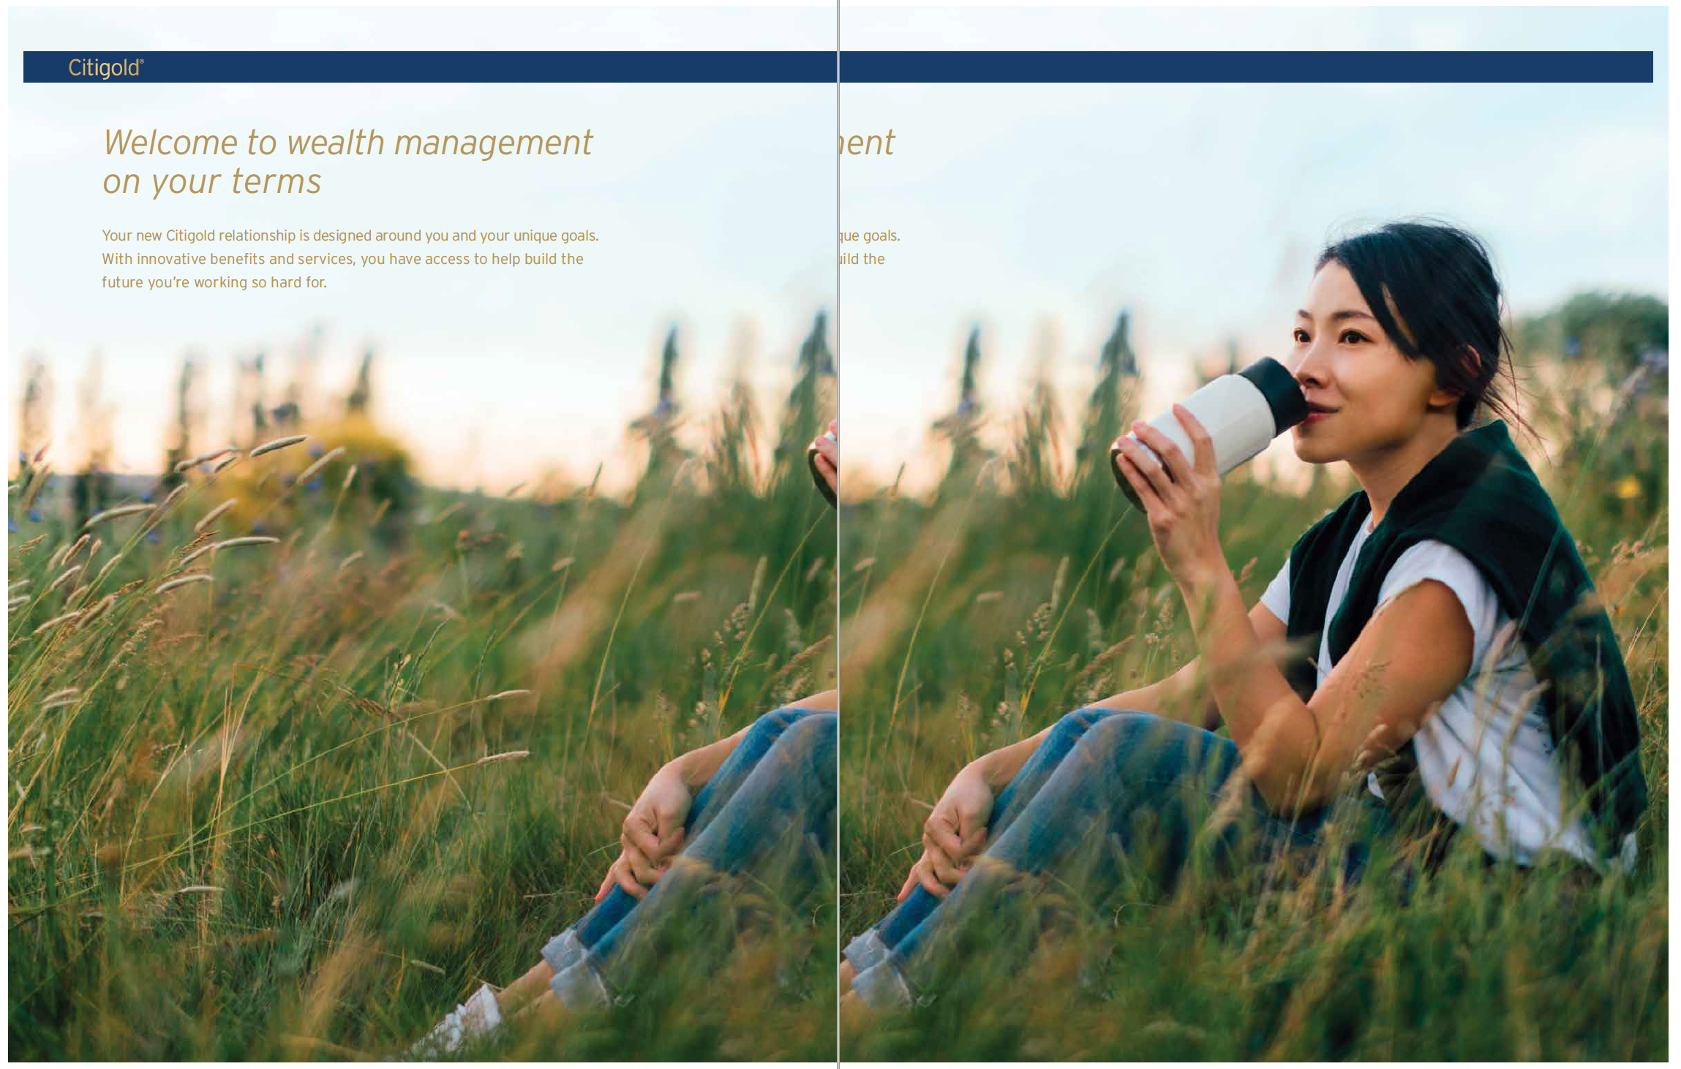
Citigold “On Your Terms”, U.S.
OWNED (IN BRANCH)
ATM, Branch External Merchandising, Branch Interior Merchandising, Branch Collateral, Salesforce Tools, MMTO/Marketing Center, Branch Digital Screens, Servicing Letters, Welcome Kits
OWNED (EVENTS & SPONSORSHIPS)
  Experiential Events and Assets (assets that go into the event including pre and post assets), Sponsorship Activation Events, Sponsorship Assets (assets that go int the sponsorship activation including pre and post assets, Partner Assets (e.g., AA owned assets)
Welcome Kit
Live: Q2’21 – Q1’22
10

Slide 11
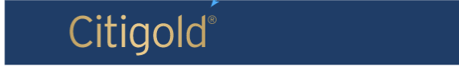
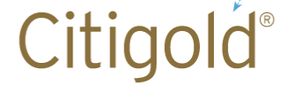

Citigold “On Your Terms”, U.S.
HIGHLIGHT PRIORITY BRANDING ELEMENTS
Please indicate Citi and product branding elements that are utilized in current work and whether they are important for upcoming work.
The Citigold product bar is used on the majority of creative assets and is deployed at the top left of a creative asset to act as a lead-in to messaging.
The Citigold word mark is used on assets that cannot accommodate the brand bar (e.g. email, paid media Custom Units)
The fill in the blank headline structure and box treatment is only relevant for the current “On Your Terms” campaign.
11

